Slide 1
Woody Plants for Brunswick County Landscapes

Slide 2
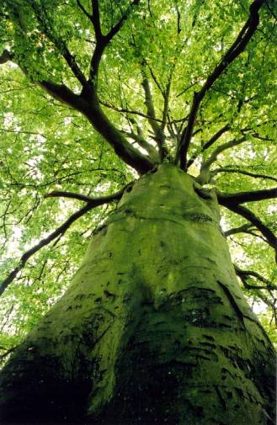
Woody Plants
Include:
  Trees
    Small: under 30’
    Large: over 30’
  Shrubs
    Small: under 4’
    Medium: 4’-8’
    Large: 8’+
  Vines
  Groundcovers

Slide 3
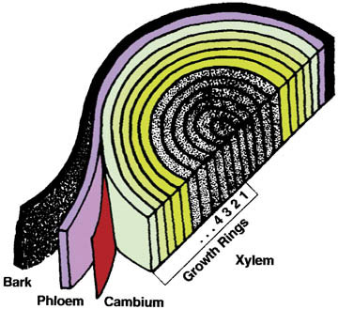
Woody Plant Stems
The only living part of woody stems is directly under the bark
If you cut through the phloem and xylem you kill the plant!
  Palms and Conifers are different
Keep weed trimmers away from tree trunks!

Slide 4
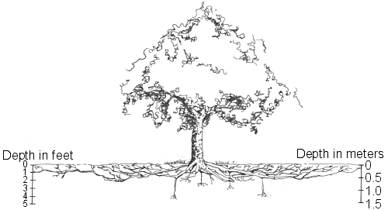
Tree Roots
Extend to 3x the width of the canopy
Feeder roots are in top 6”-12” of the soil
  So are grass roots: be careful with herbicides!
  Protect during construction

Slide 5
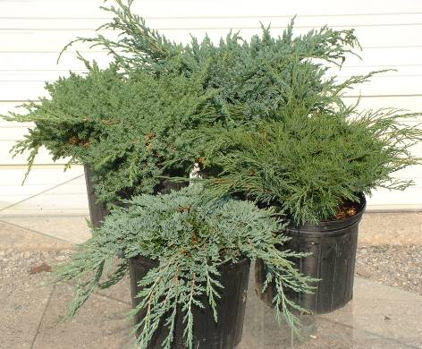
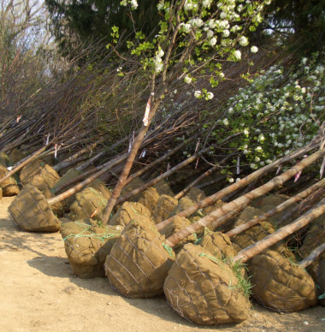
Buying and Planting Woody Plants
Container Grown versus Balled and Burlapped
All roots contained – may be circling
Much of root system cut – root ball wrapped in burlap and wire basket

Slide 6
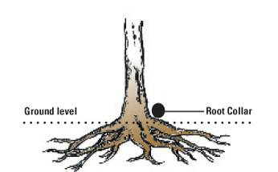
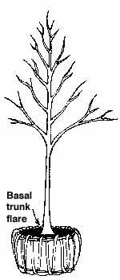
Buying Quality Trees
Want to see root collar and trunk flare on trees
Potted and Planted trees should NOT look like a light pole!

Slide 7
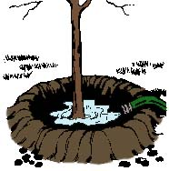
Planting Trees and Shrubs
Dig a $5 hole for a 5 cent plant!
No deeper than depth of root ball
  Planting too deep common cause of woody plant failure
2 to 3 times wider than root ball
Amend planting bed, not just planting hole
Water in well to avoid air pockets
Build small berm to hold water – remove after first season

Slide 8
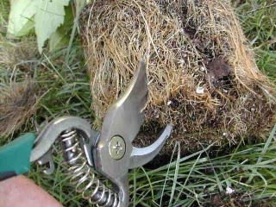
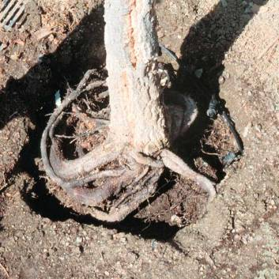
Planting Woody Plants
Container Grown
Always check for circling roots!
Cut through circling roots and break up the root system of root bound plants
If not cut, circling roots will continue to circle and may eventually girdle trees
Can be planted year round as long as can keep watered – fall best time to plant

Slide 9
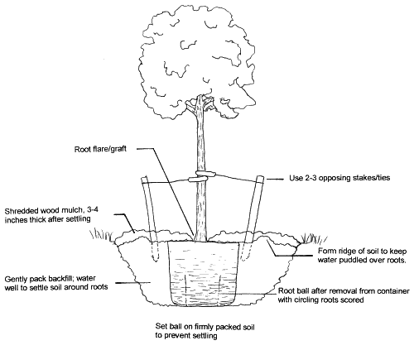
Planting a container grown tree or shrub

Slide 10
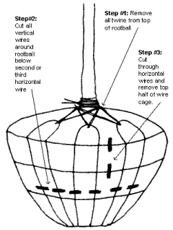
Planting Woody Plants
Balled and Burlapped
  Cut wire basket and pull back burlap from top 1/3 to 1/2 of root ball
  Do not break up root ball
  B&B plants transplant best when dormant (late fall – early spring)
  Adapt best when going to lighter texture soils (eg. clay rootball to sandy soil)

Slide 11
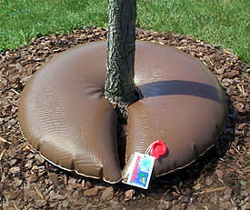
Establishing Woody Plants
The 1st year it sleeps, the 2nd year it creeps, the 3rd year it leaps!
Water every few days for first few weeks then cut down to once a week through first season if no rainfall
Mulch!
Most trees take 2-3 years to become fully established
Tree Gator – slowly releases water to the root zone over several hours

Slide 12
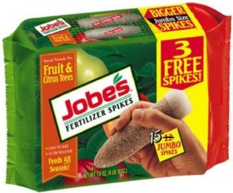
Fertilizing Woody Plants
Incorporate lime, phosphorous (P) and potassium (K) at planting according to soil test results – No nitrogen (N) first year, want root growth not top growth!
  Exception = extremely sandy soils
Soil test every 3rd year
Standard Nitrogen recommendation: 1 lb of actual N per 1000/ft per year
Best applied in early spring
Use slow release fertilizer
Avoid fertilizer spikes – They are not very effective

