Slide 1

Bald Head Association Member Survey - July 2016
Thursday, August 11, 2016

Slide 2
193 Total Responses
13% response rate
BHA Member Survey
Date created: Friday, July 15, 2016
Responses gathered: July 15-24, 2016

Slide 3
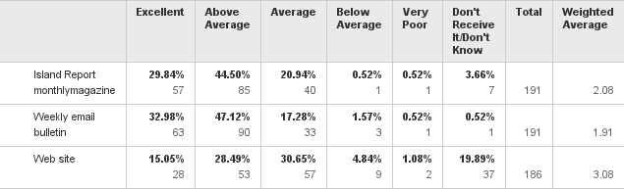
Q1: Please rate the effectiveness of Bald Head Association'scommunications.
Answered: 192 Skipped: 1
Above average to Excellent:
Island Report = 74%
Weekly email = 80%
Web site = 44%

Slide 4
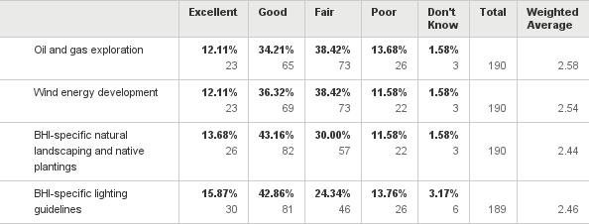
Q2: How would you rate your knowledge of the following:
Answered: 190 Skipped: 3

Slide 5
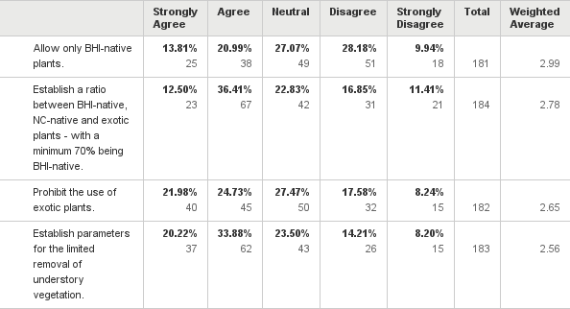
Q3: In order to protect the long-term ecology and beauty of the Island, Bald Head Association is re-evaluating regulations regarding residential landscaping. Please state your position on the following:
Answered: 185 Skipped: 8
Agree or Strongly Agree
Only BHI native: 35%
Ratio: 49%
Prohibit exotic: 47%
Understory: 54%

Slide 6
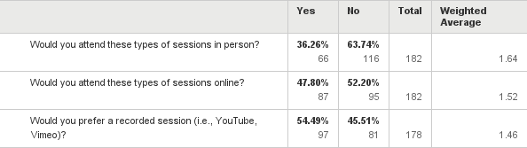
Q4: Bald Head Association is considering hosting information sessions on green building practices, such as solar, geothermal, water conservation, etc.
Answered: 184 Skipped: 9

Slide 7
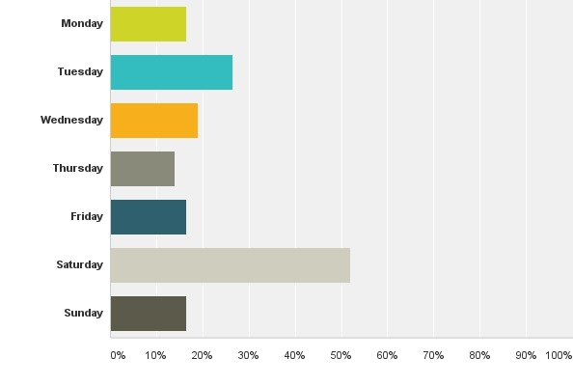
Q5: If you would be interested in attending these sessions in person, what day of the week would you prefer?
Answered: 79 Skipped: 114

Slide 8
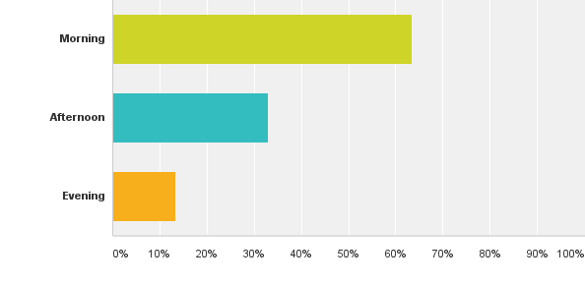
Q6: What time of day works best for you?
Answered: 82 Skipped: 111

Slide 9
Open-ended question:
What is the one thing you would change about BHI?
139 individual responses
Topics range from renewed focus on native plantings and recycling to softening/hardening the PSD approach and better internet access
Other issues: less governmental involvement, limited commercialism, changing island demographics, costs of living on BHI, transportation options and fragmentation of decision making

