Slide 1

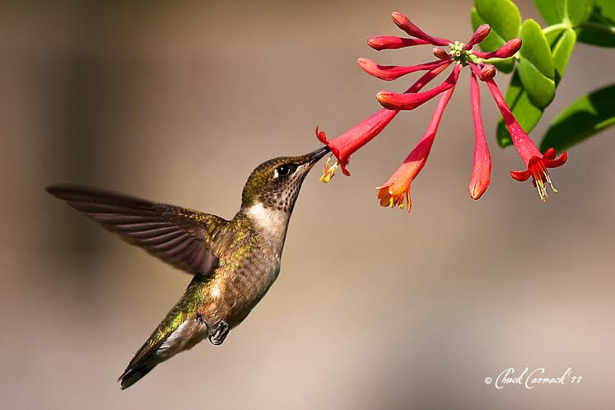
Bird-Friendly Bald Head Island
Kim Brand, Audubon North Carolina
Notes:
Thank you Mark Prak for bringing me here, Mark and Robin for hosting me, and Karen Mosteller for setting up this wonderful afternoon with you all.
Thank you for coming.
Believe it or not, I’ve lived in North Carolina for 10 years and this is my first visit to Bald Head –
-- and certainly not the last, now that I’ve experienced it!

Slide 2
Vision:
Bird-Friendly Communities across North Carolina give birds the opportunity to succeed by providing connected habitat dominated by native plants; minimizing hazards posed by the built environment; and engaging people of all ages and backgrounds in stewardship of nature.
Notes:
Bird-Friendly Communities focuses on helping birds thrive alongside people.
Lots of things you can do here, in your own yards and as you manage your island, to help birds continue to thrive here as more people move onto the island. More important than ever!

Slide 3
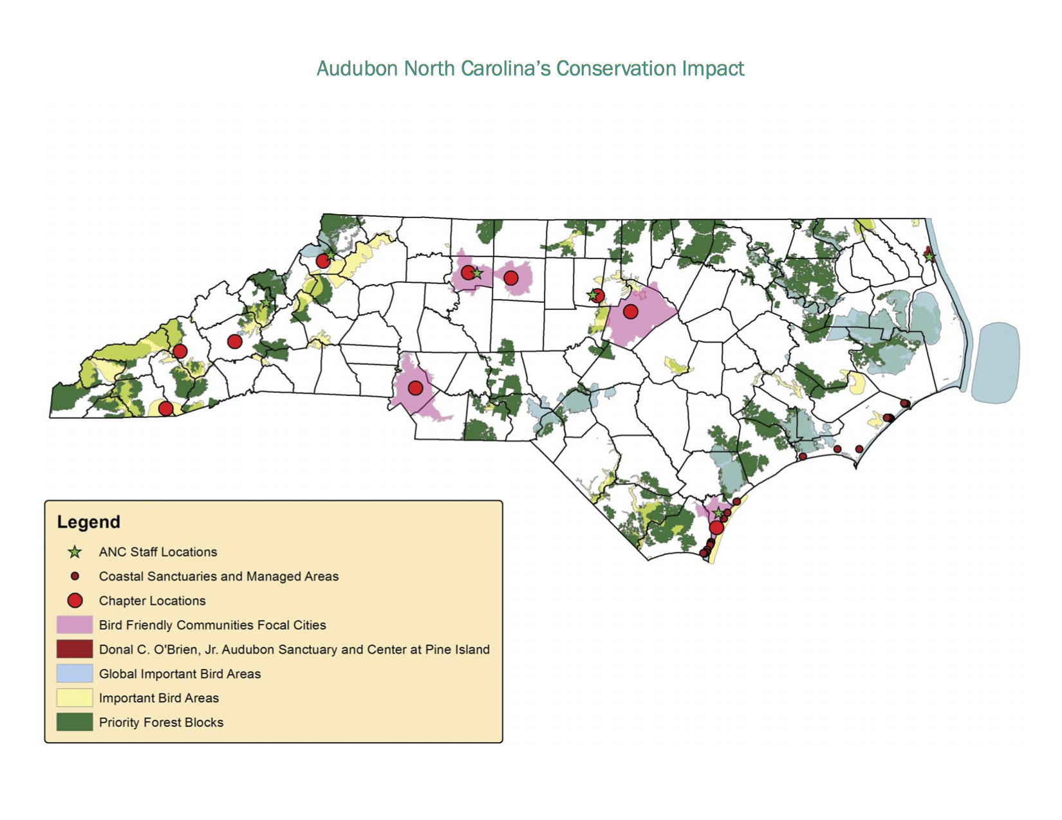
Notes:
Introduce state Audubon chapter

Slide 4
Notes:
Introduce state Audubon chapter

Slide 5
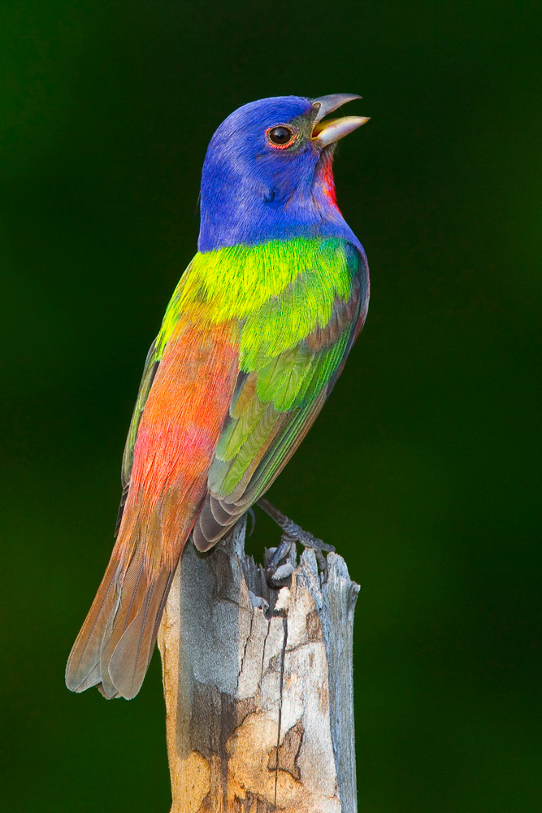
Bald Head-Smith Island IBA
  Largest population of Painted Buntings in the state
  Globally significant for Painted Buntings
Duane Angles/Audubon Photography Awards
Notes:
Mr. Painted Bunting is singing the praises of Bald Head Island!

Slide 6
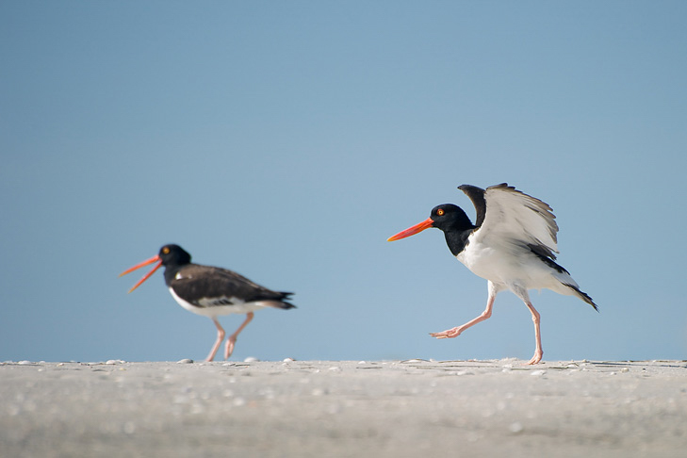
Largest population of American Oystercatchers in the state
Matthew Hansen/Audubon Photography Awards

Slide 7
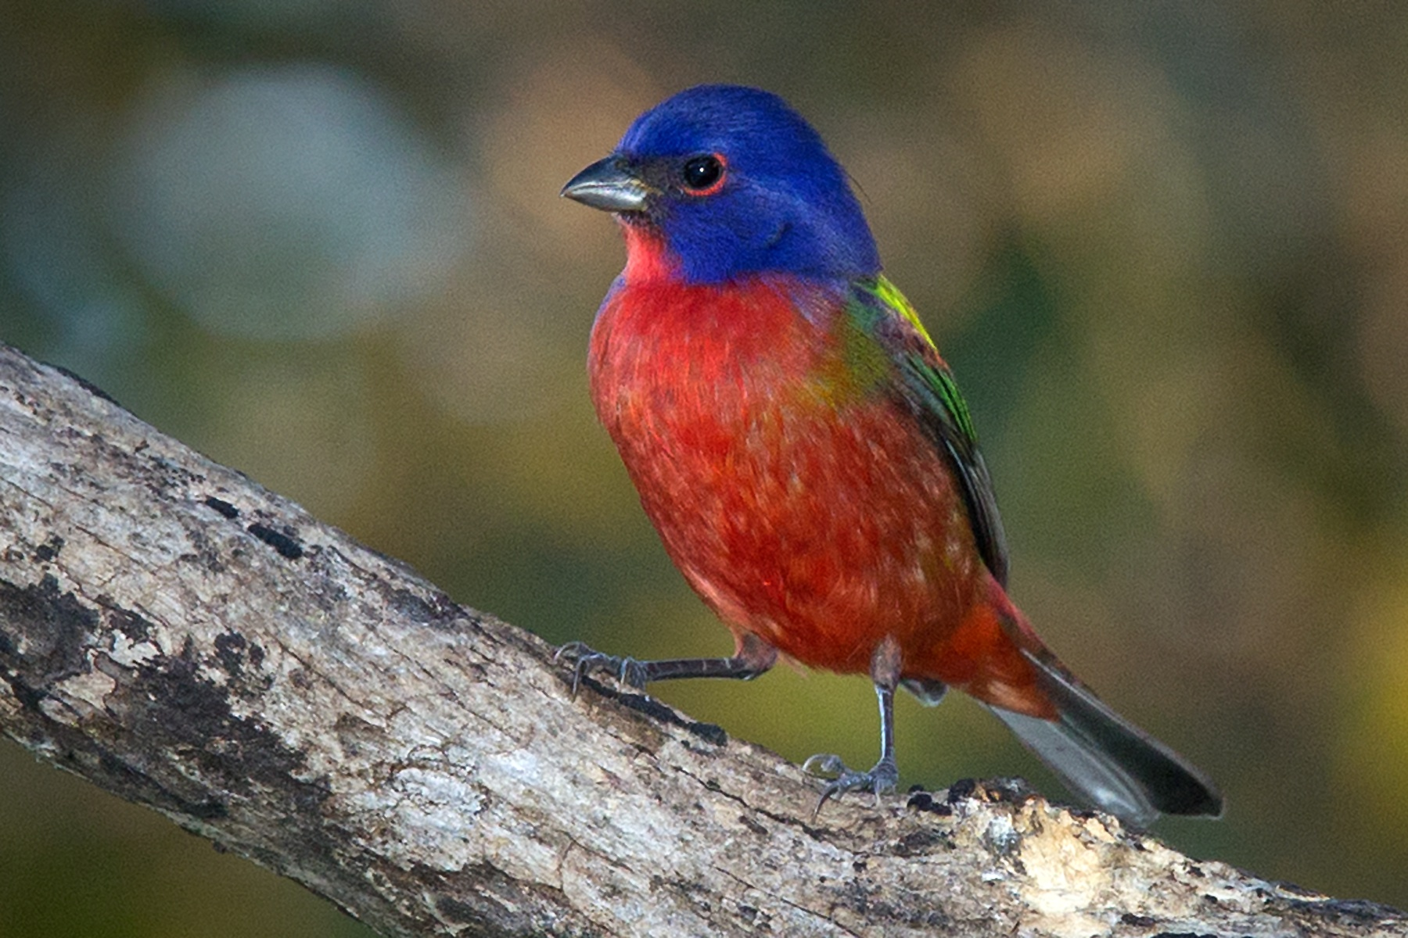
2018 Bird of the Year
Audubon NC
Bird-Friendly Communities
Donald Mullaney
Notes:
Do any of you remember the first time you saw a Painted Bunting?
(ask for stories)
My story – on a Christmas Bird Count in central Florida – 3 young female graduate students and an expert birder (boss of the other two and a member of my thesis committee). A bird flew in front of the truck and dove into a ditch. All the girls shrieked – I saw blue! I saw red! I saw green! And he just shook his head, cursed under his breath, and pulled over the truck. We all stood there peering into this dark, tangled mess of a ditch, and finally he saw it: Oh, he said. A Painted Bunting. I thought you were all nuts, but you were in fact all right.

Slide 8
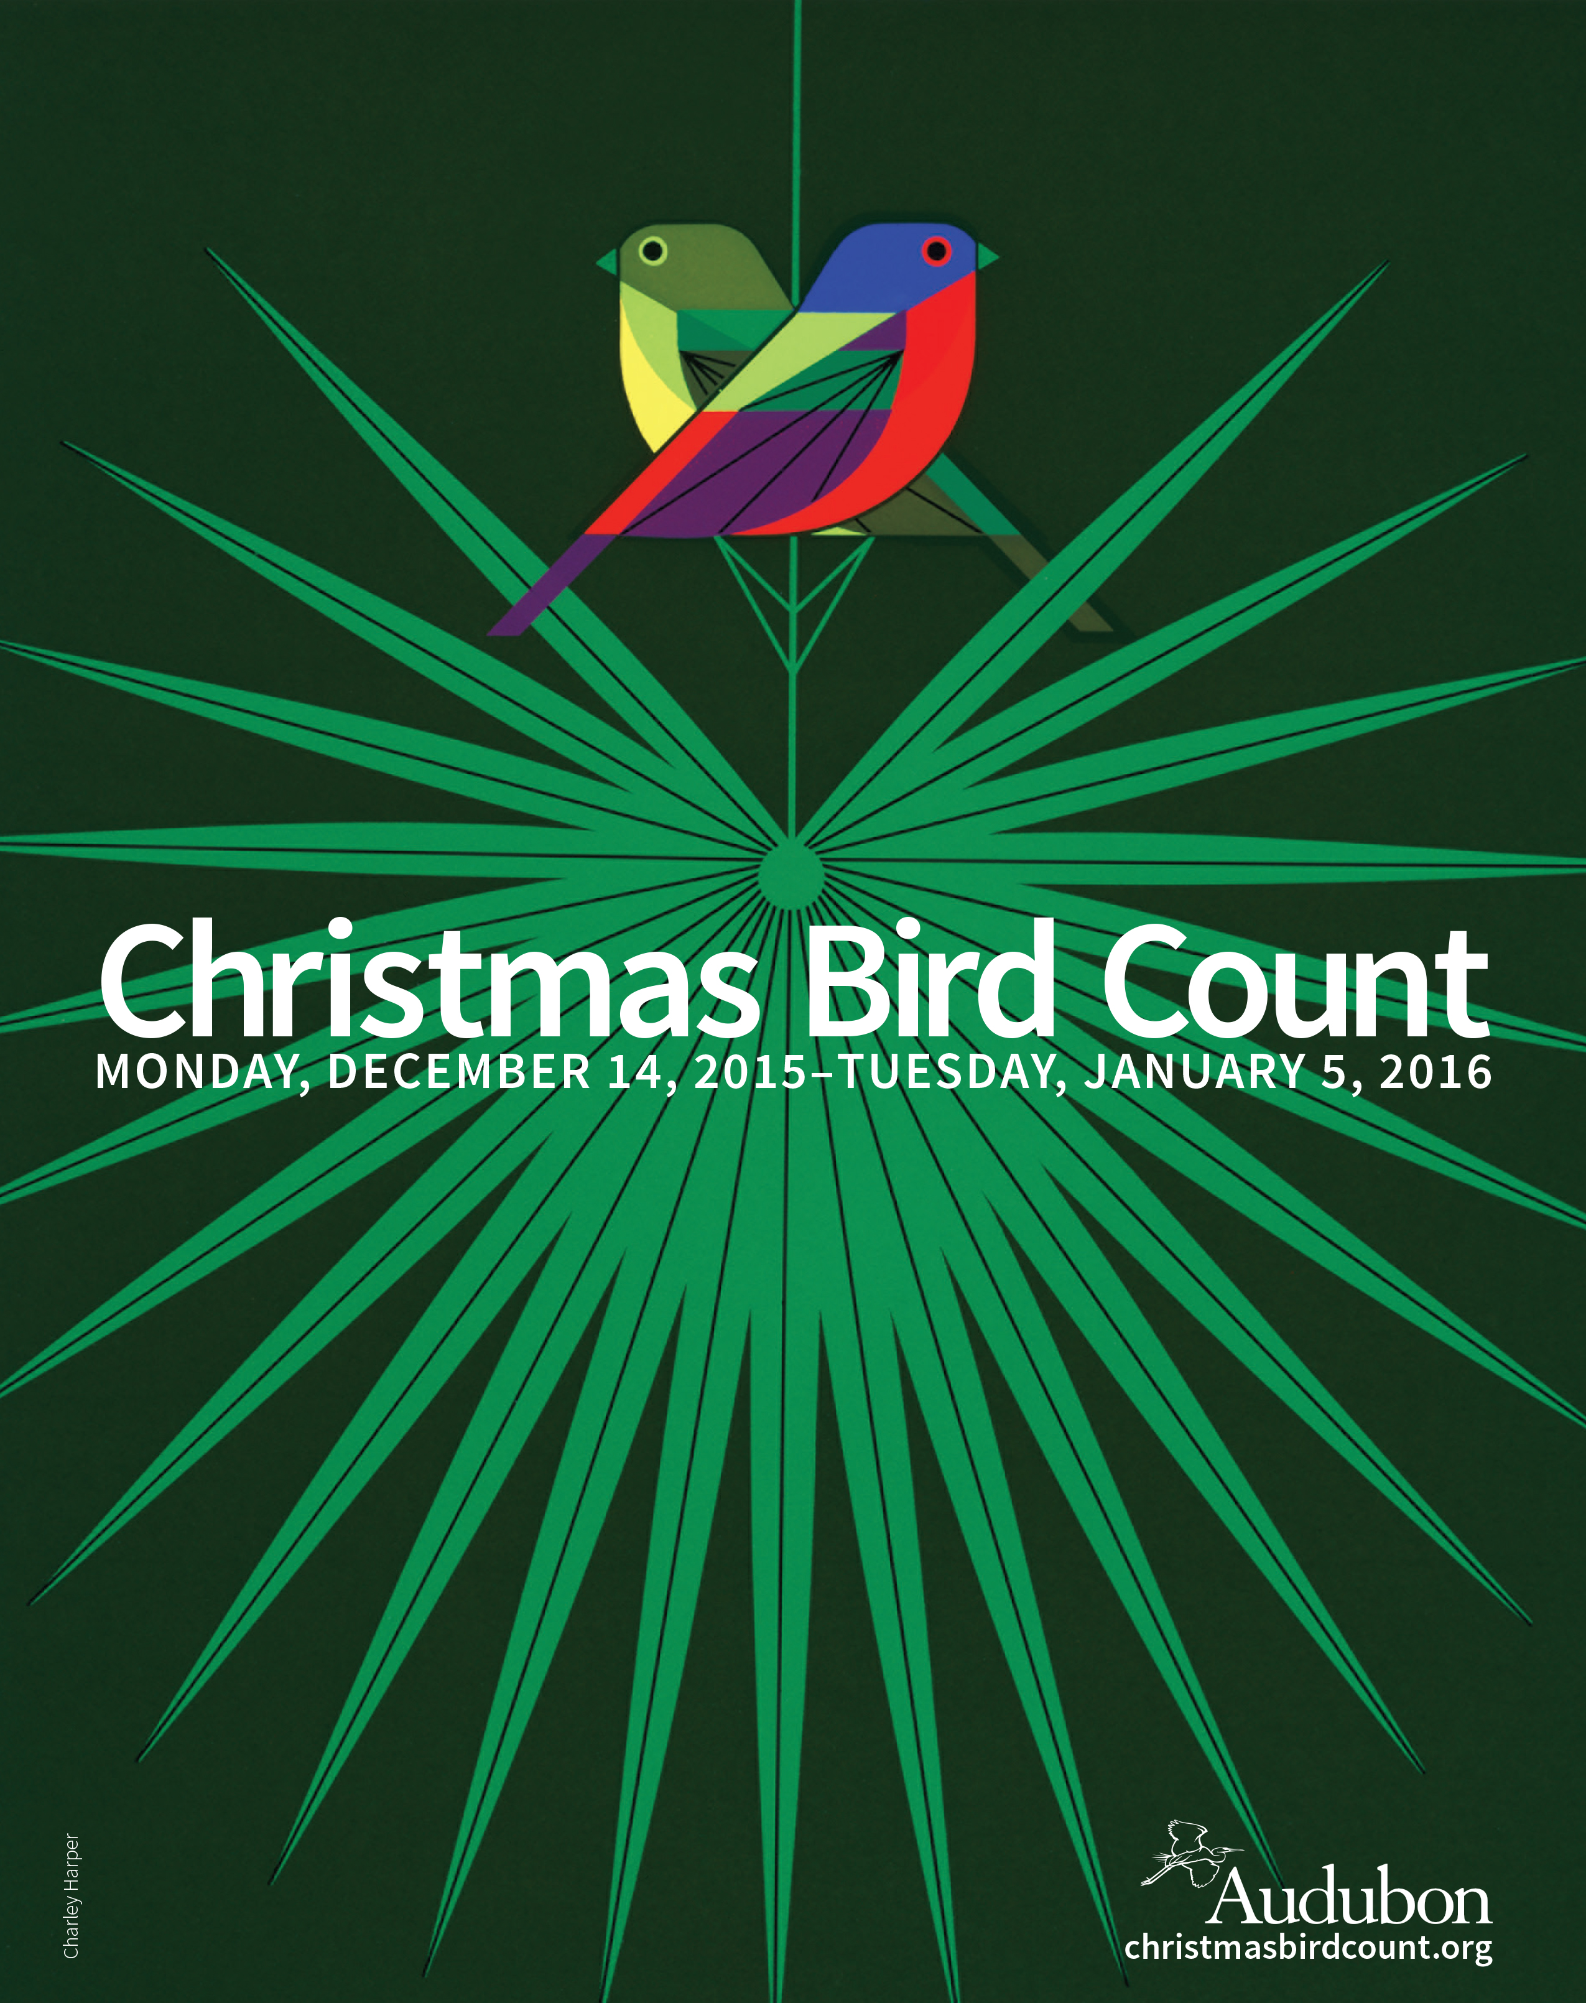
Southport/Oak Island/Bald Head
  30 years
  First 1959
  148 to 179 species – among highest in NC
  Cape Fear Audubon Society organizes the count

Slide 9
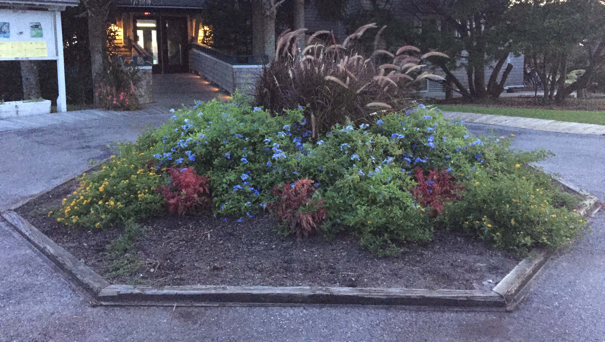
Keep Bald Head Bald Head!

Slide 10
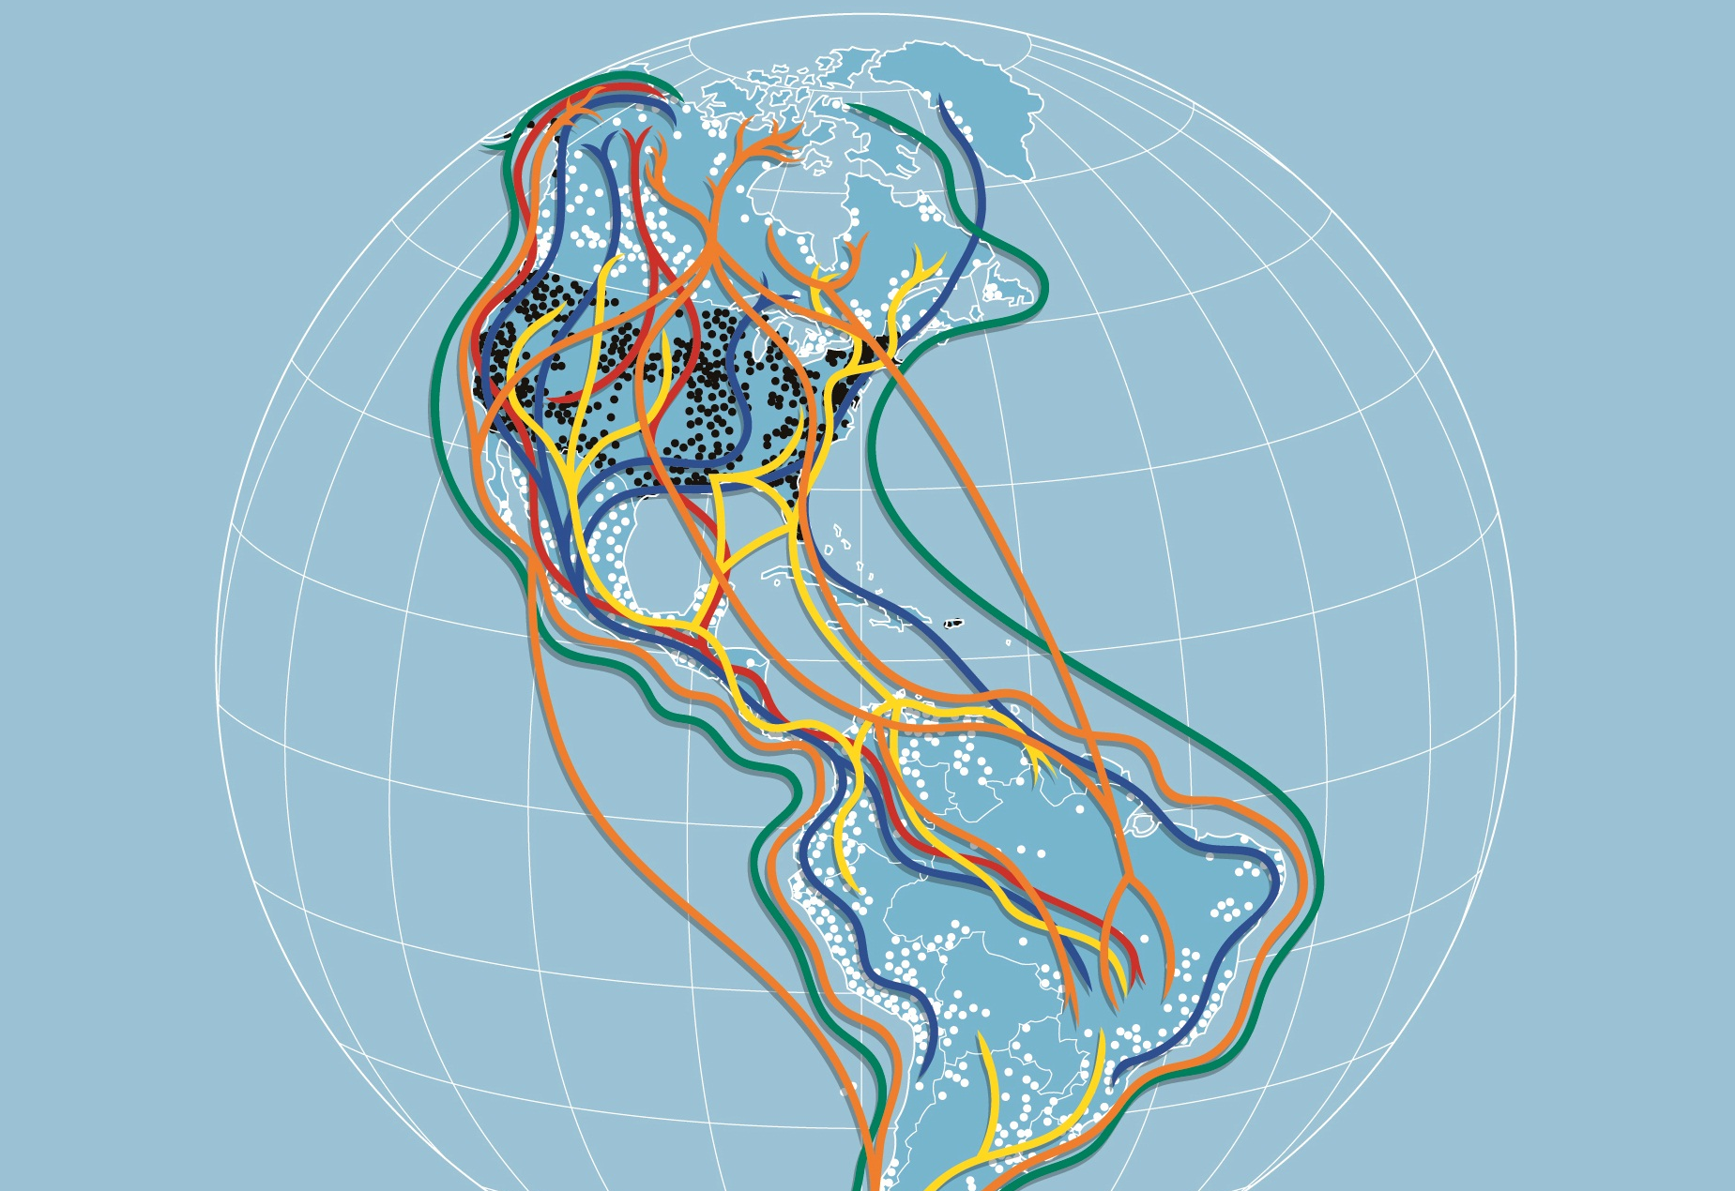
National
Audubon Society
Notes:
One reason why cities & towns – your yard! – matters so much:
High-flying view:
Birds migrate along these superhighways in the sky: flyways
Many birds – especially songbirds – migrate at night
(cooler so saves energy; won’t be eaten by hawk)
Birds stop and rest wherever they run out of fuel, or wherever they make it to before dawn
They can’t always stop in a State Park or National Wildlife Refuge
They may stop in your yard, your local park, even in the middle of the city

Slide 11
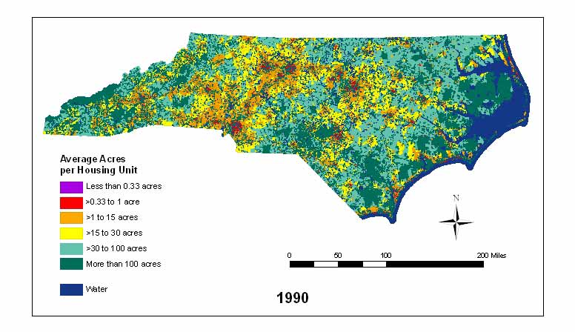
Housing Density
Green Growth Toolbox
NC Wildlife Resources Commission
Will Stuart
Notes:
This is why we need to work in cities and towns
Warmer colors have more houses per acre
This is 1990
NC is one of the fastest-growing states in the nation…

Slide 12
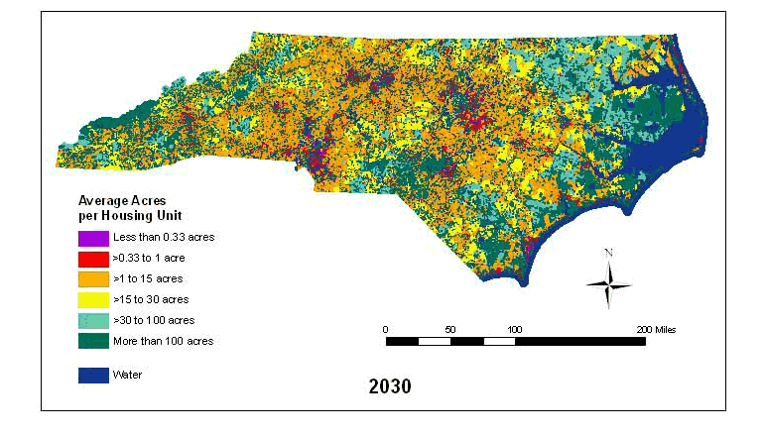
Projected Housing Density
Green Growth Toolbox
NC Wildlife Resources Commission
Will Stuart
Notes:
This is 2030 – only 15 years from now
We have fewer undeveloped areas in our state, and that makes yards, city parks, school and corporate campuses, church grounds much more important to the health of our birds.

Slide 13
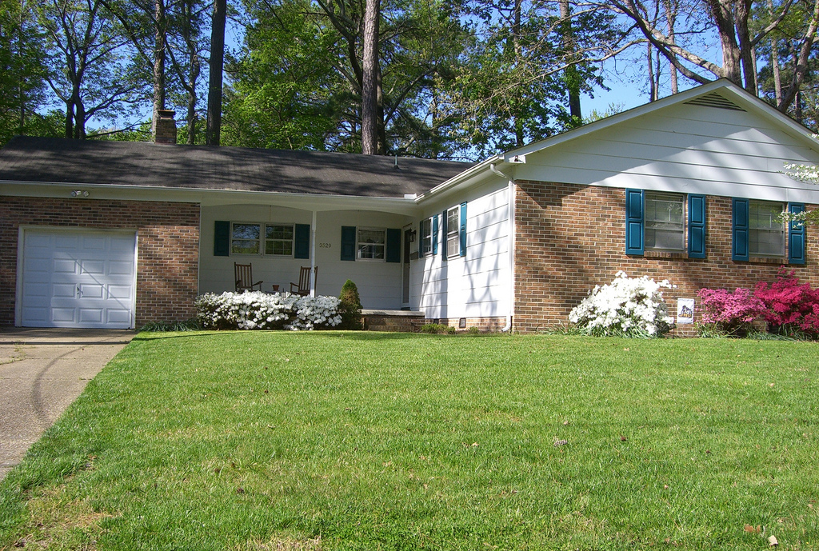
79% of plants non-native
Mr. Throk, Flickr Creative Commons
Notes:
Almost 80% of plants in our human-dominated areas are not native.
Will explain why that matters.

Slide 14
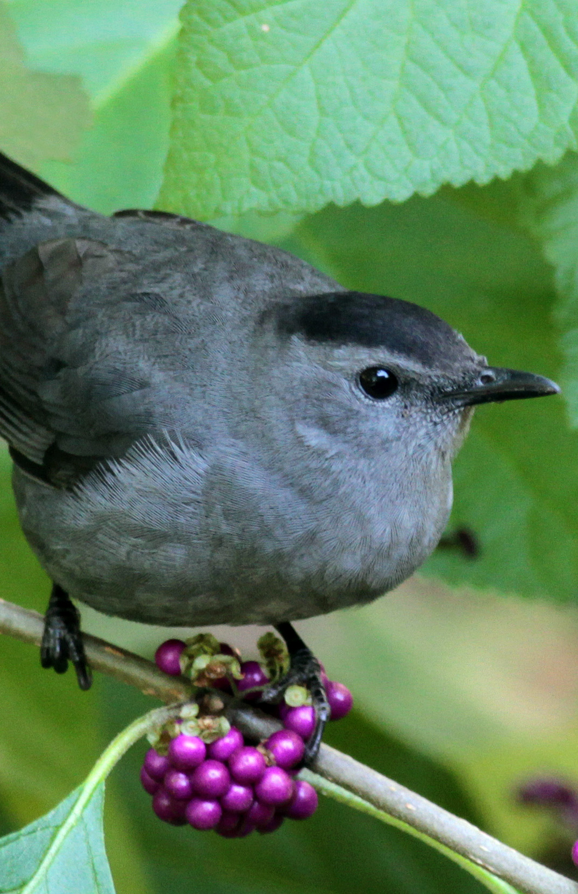
Four Food Groups
for Birds
  Berries & fruits
  Insects
  Nuts & seeds
  Nectar
Will Stuart
Notes:
Northern Mockingbird on Winterberry – one of our native deciduous hollies – good food for birds in winter
What can make your yard bird-friendly?
Four food groups
Good to think about whether your yard provides these 4 food types for as many seasons of the year as possible – especially berries – summer, fall, winter… nectar for hummingbirds the whole time they are with us, April through September.
A small yard can support many birds with some planning.

Slide 15
Food Group #1: Berries & Fruits

Slide 16
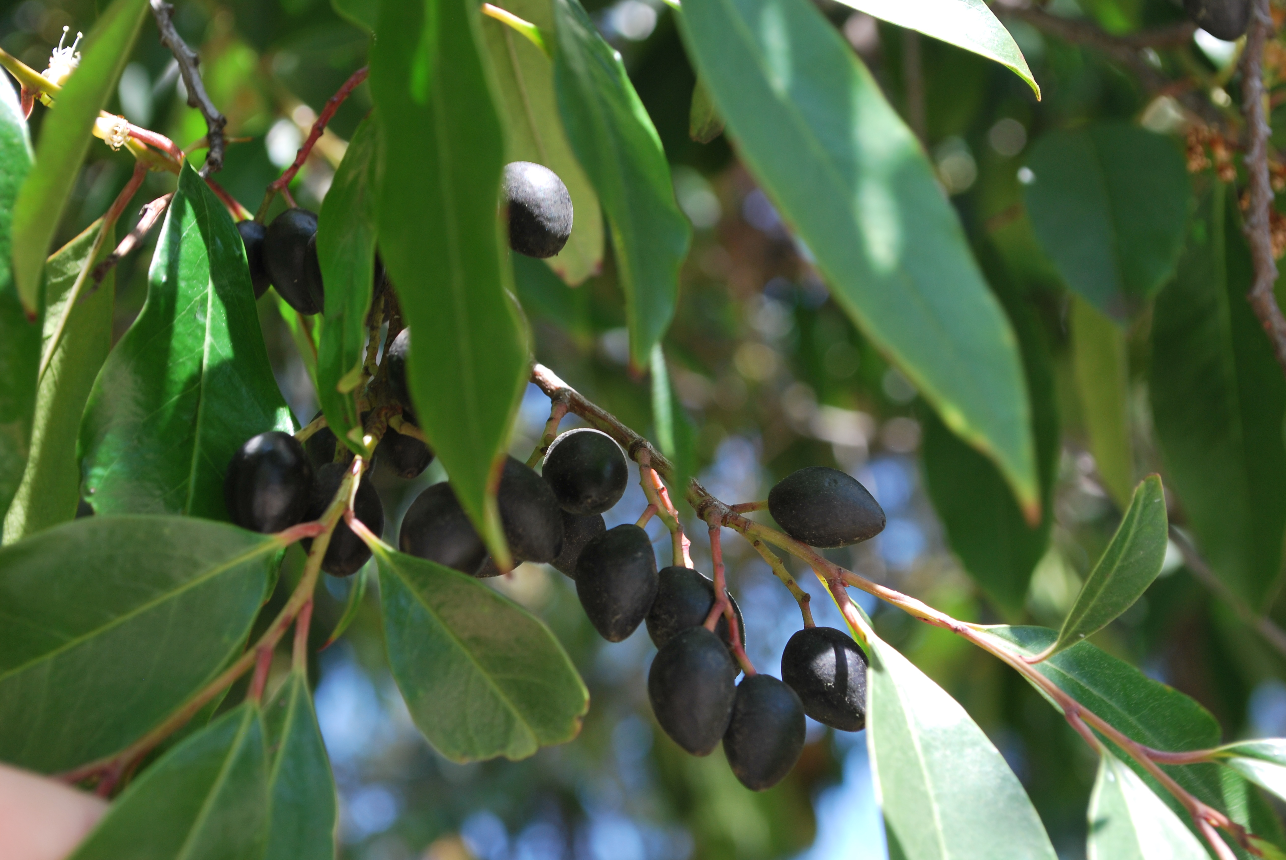
Carolina Cherry Laurel
Bri Weldon – Flickr Creative Commons
Notes:
Dogwood berries – Cornus florida (NOT kousa dogwood) – are about 25% fat – also sought after by migrating songbirds.

Slide 17
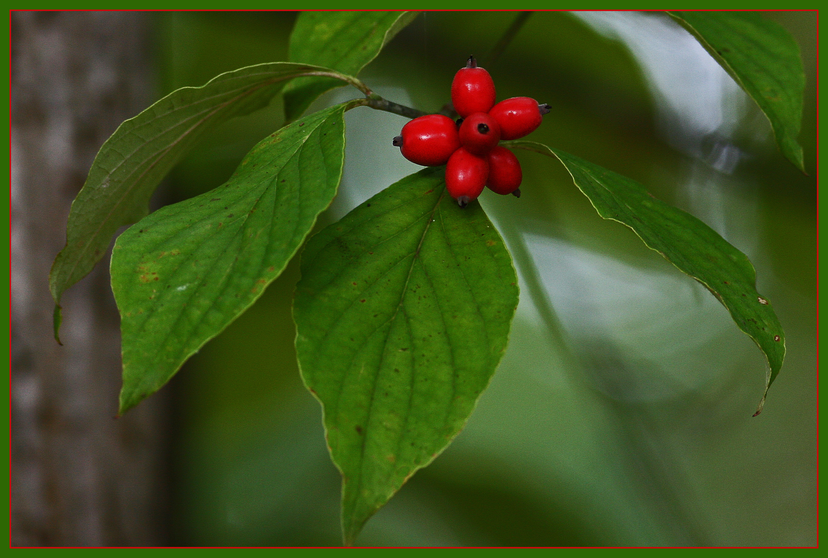
Dogwood
Will Stuart
Notes:
Dogwood berries – Cornus florida (NOT kousa dogwood) – are about 25% fat – also sought after by migrating songbirds.

Slide 18
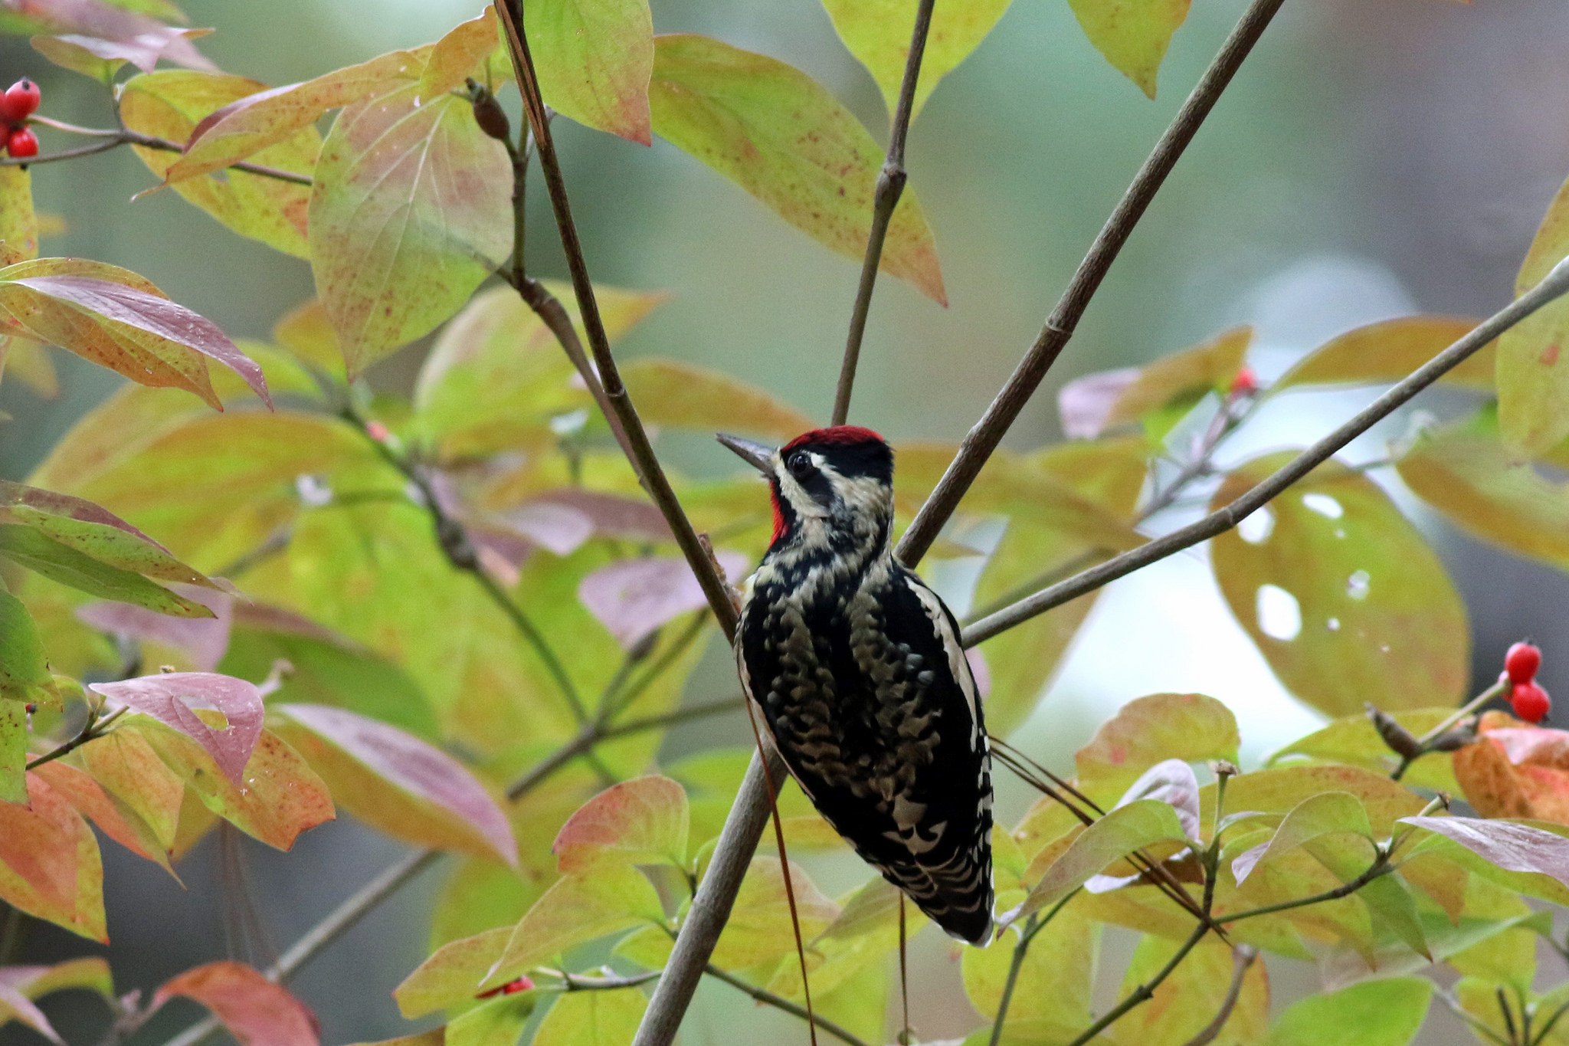
Dogwood
Will Stuart
Notes:
Dogwood berries – Cornus florida (NOT kousa dogwood) – are about 25% fat – also sought after by migrating songbirds.

Slide 19
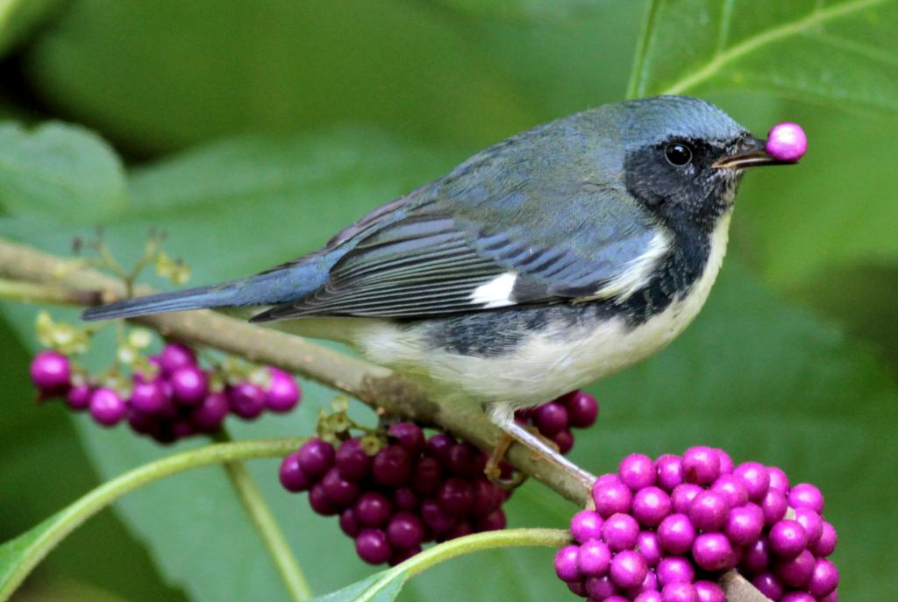
American Beautyberry
Black-throated Warbler – Will Stuart
Notes:
Warblers might not tackle a big spicebush berry, but Beautyberry is ideal and a total bird magnet

Slide 20
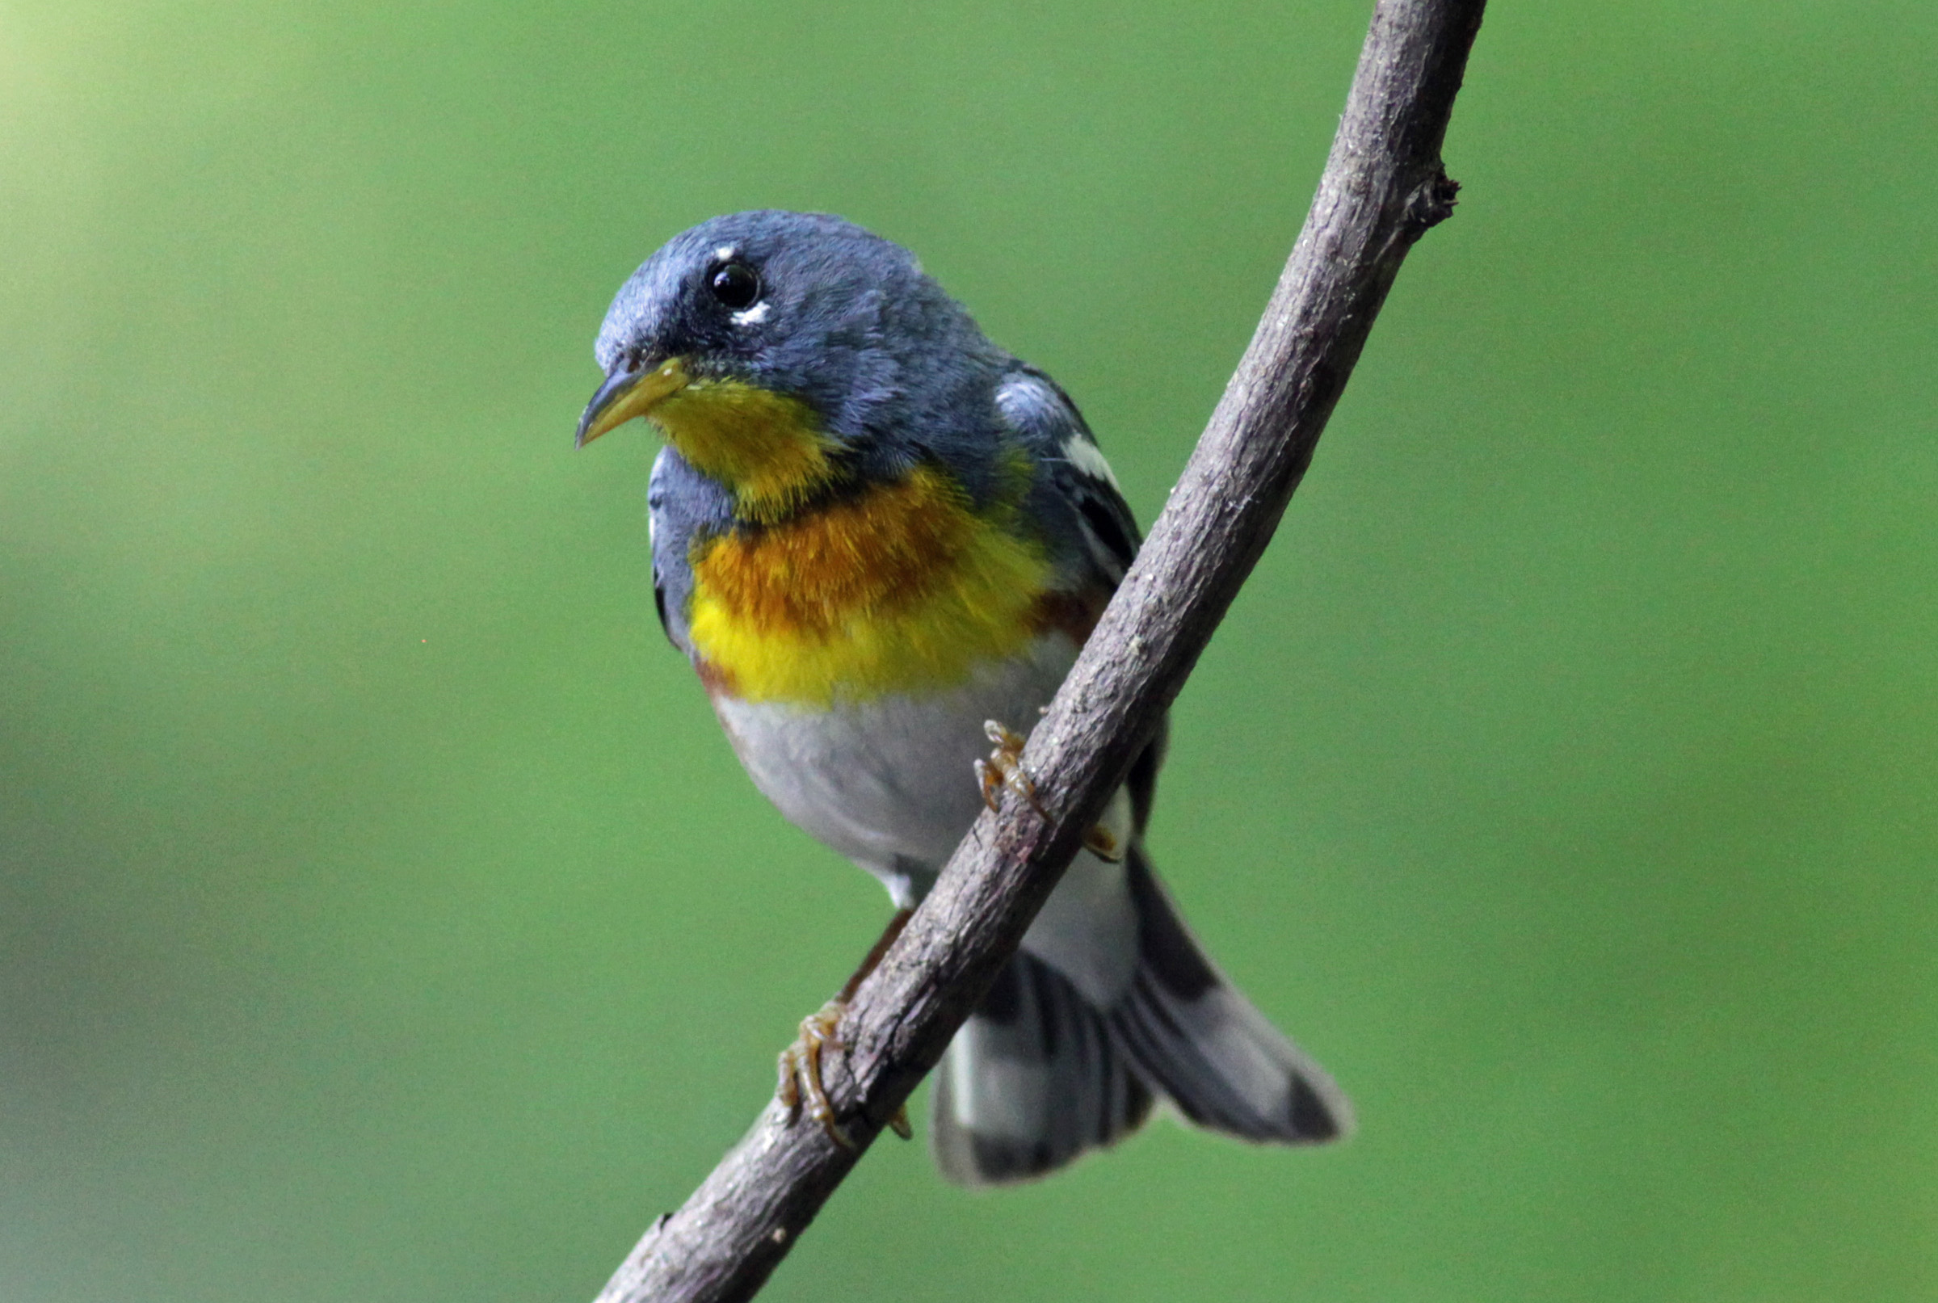
Northern Parula – Will Stuart

Slide 21
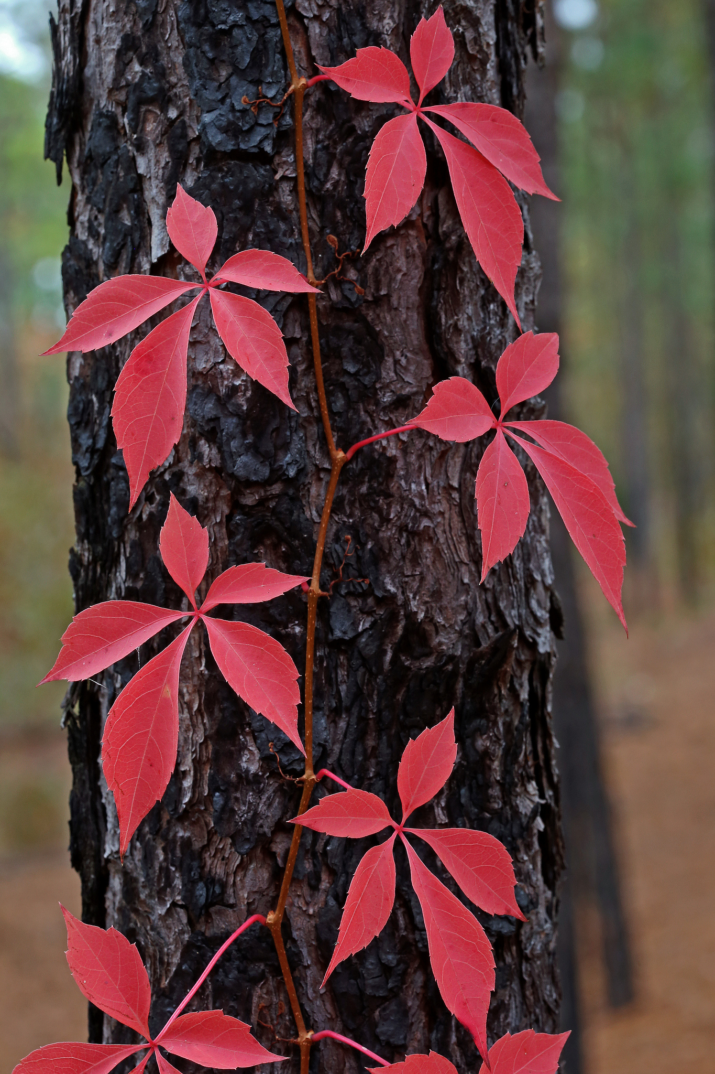
Virginia Creeper
Will Stuart
Cedar
Waxwing
Will Stuart

Slide 22
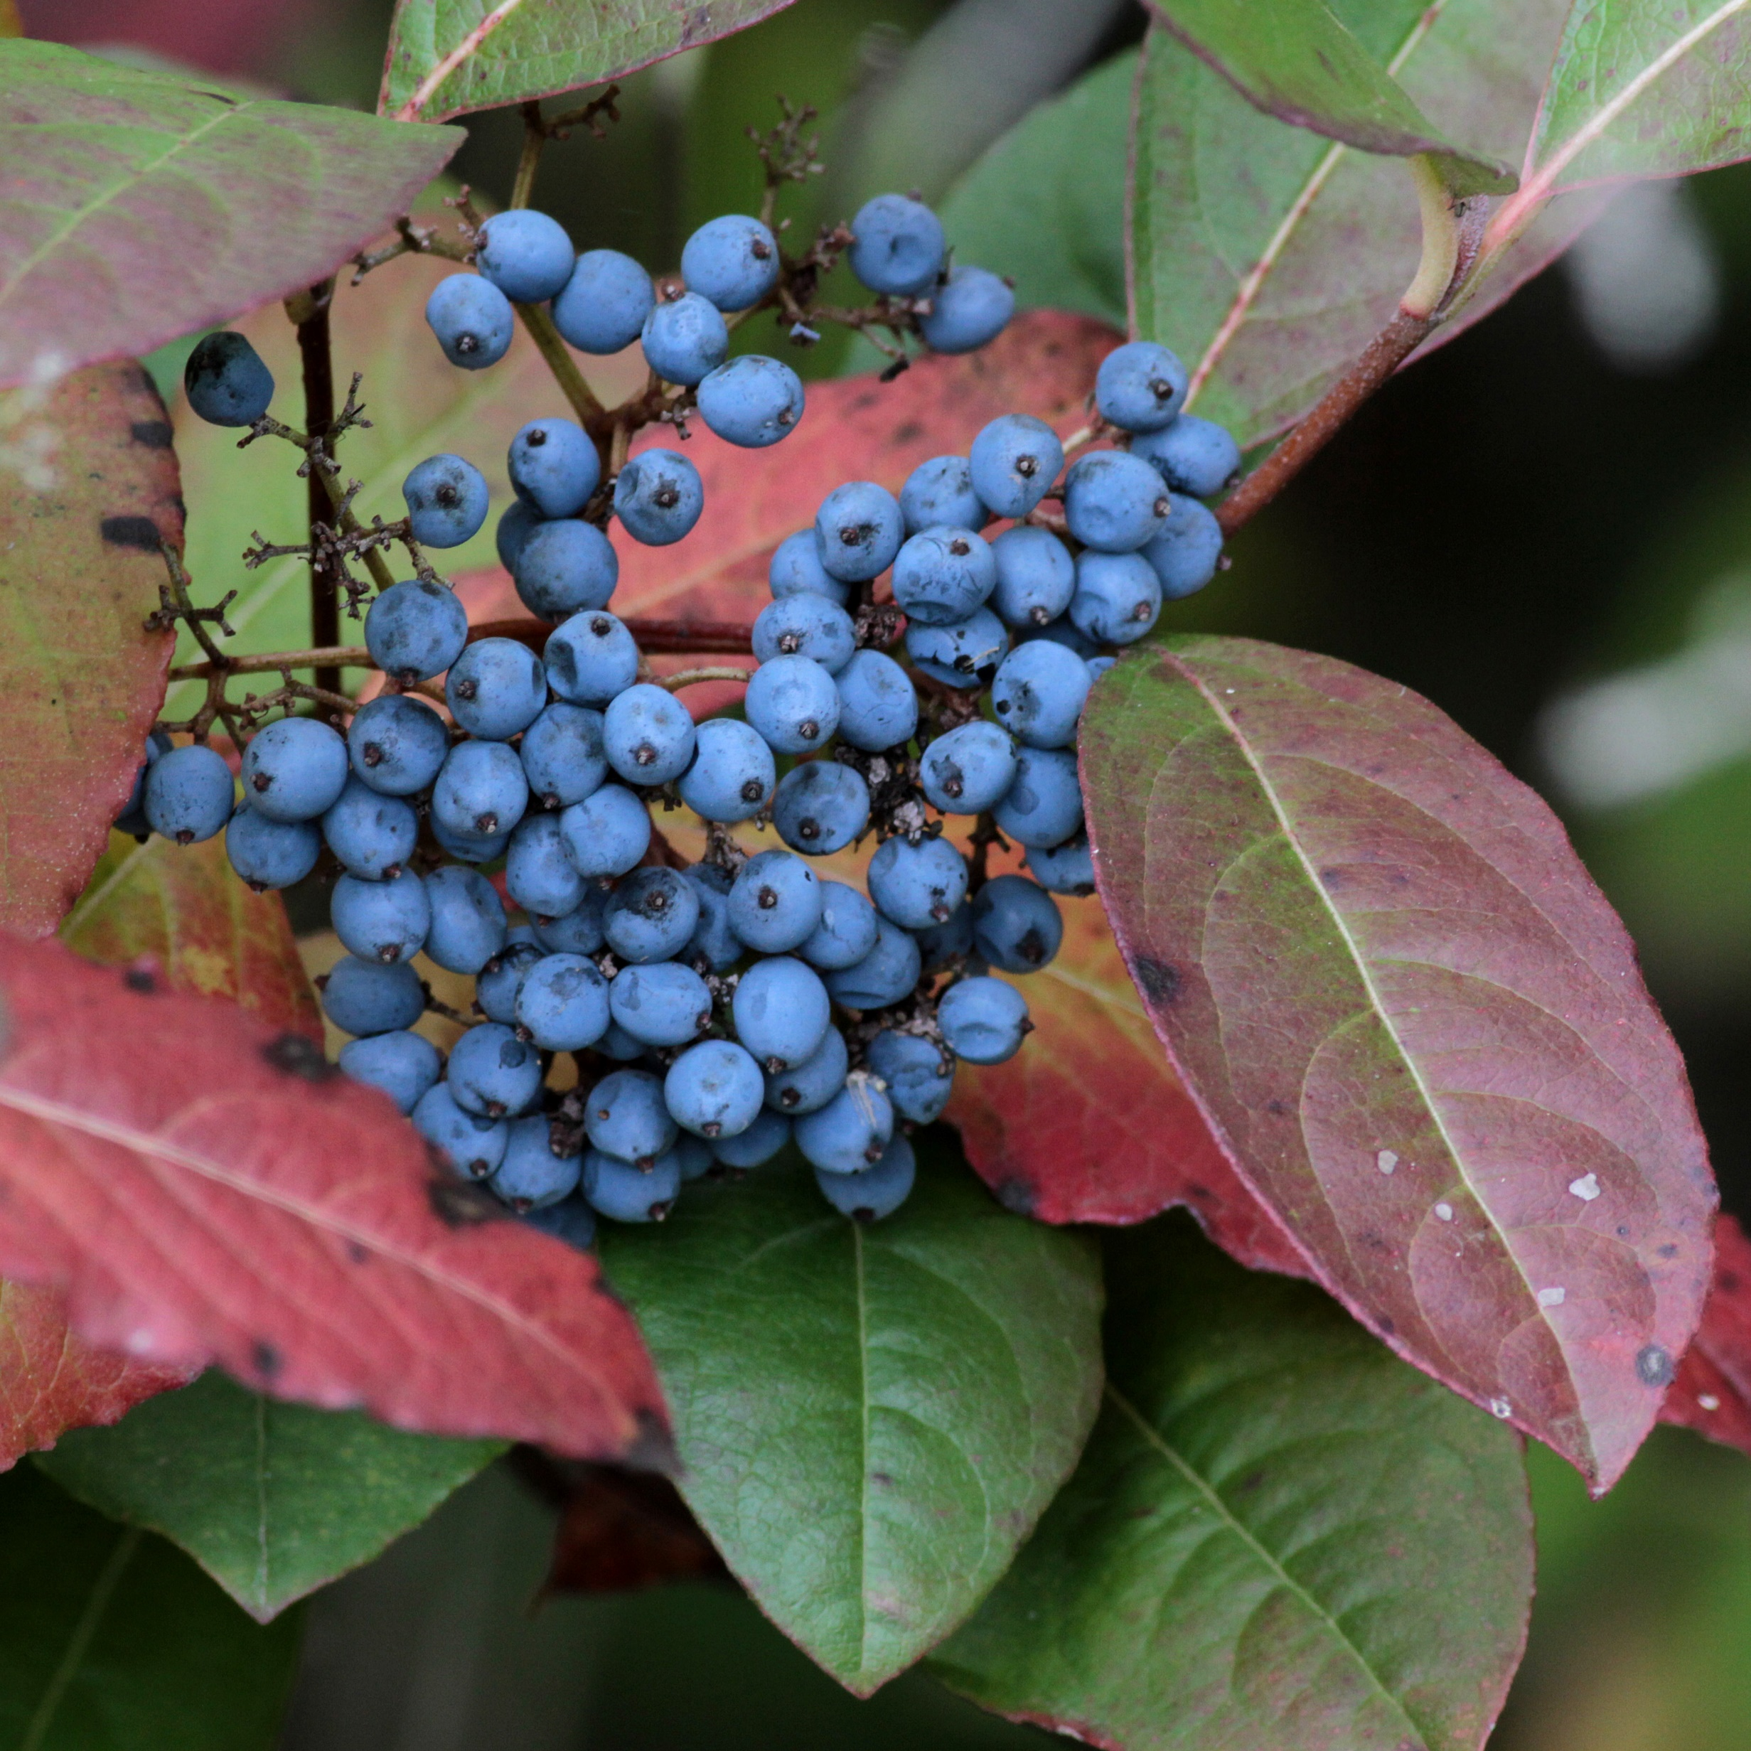
Viburnum nudum (BC native)
Will Stuart
Notes:
Berries Aug-Oct

Slide 23
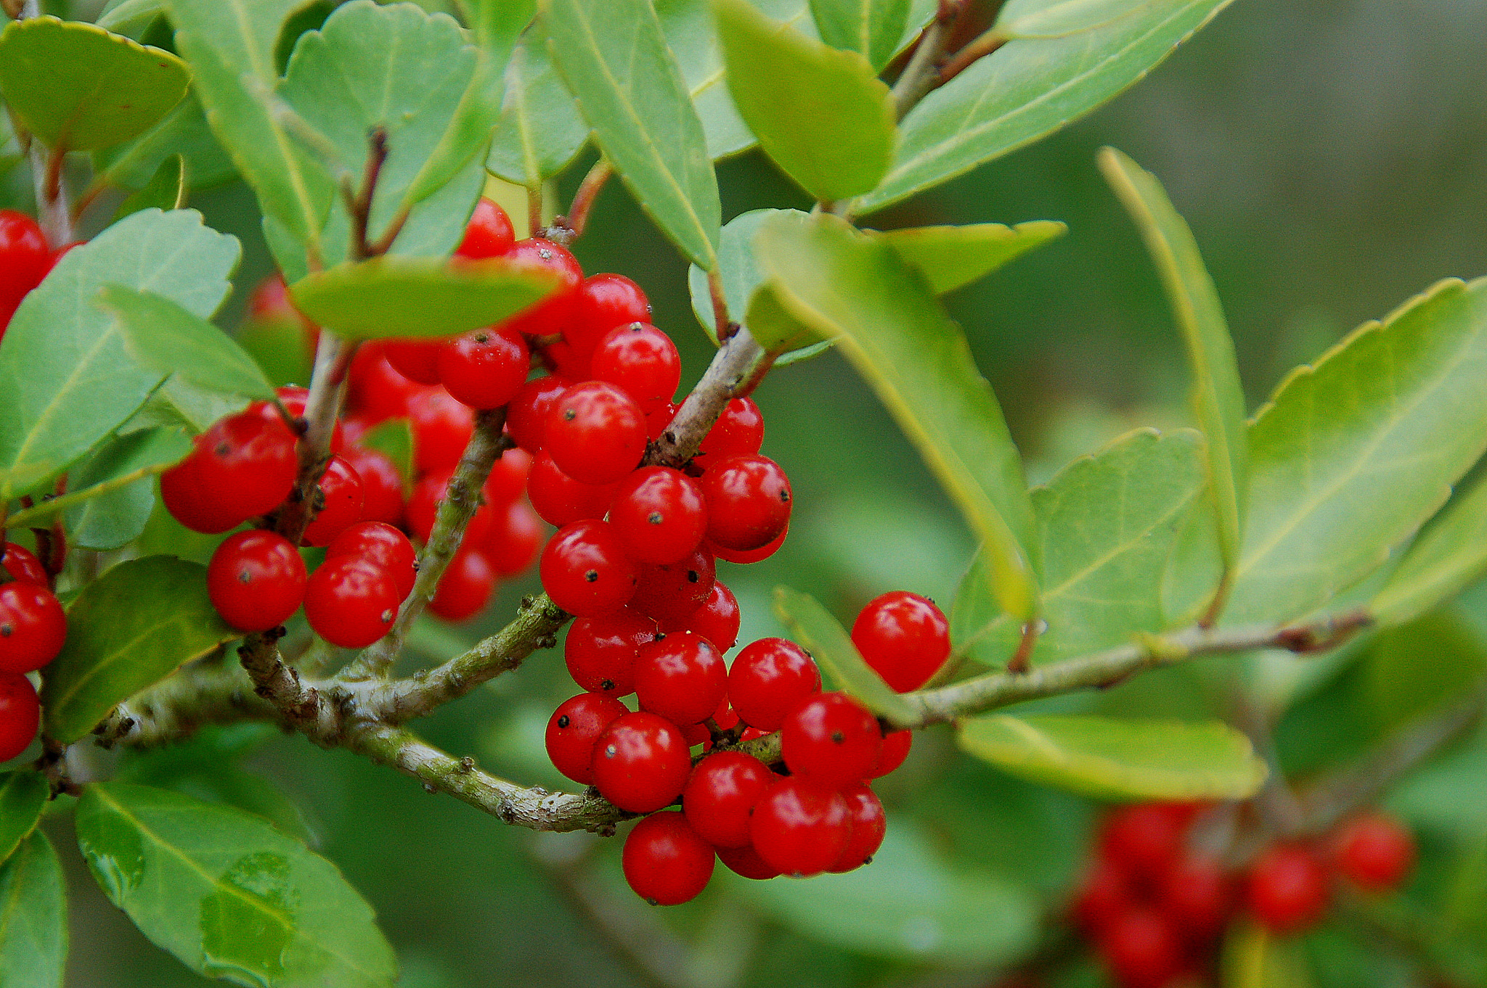
Yaupon Holly
Keith Ewing – Flickr Creative Commons
Will Stuart
Notes:
Berries Aug-Oct

Slide 24
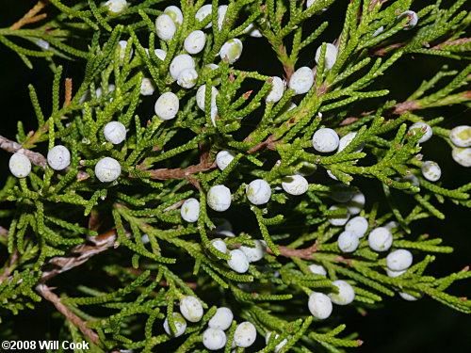
Coastal Red Cedar
Will Cook
Cedar
Waxwing
Will Stuart
Notes:
More berries for winter
Waxwings, bluebirds, robins, thrashers, also goldfinches
Allstar plant – evergreen too

Slide 25
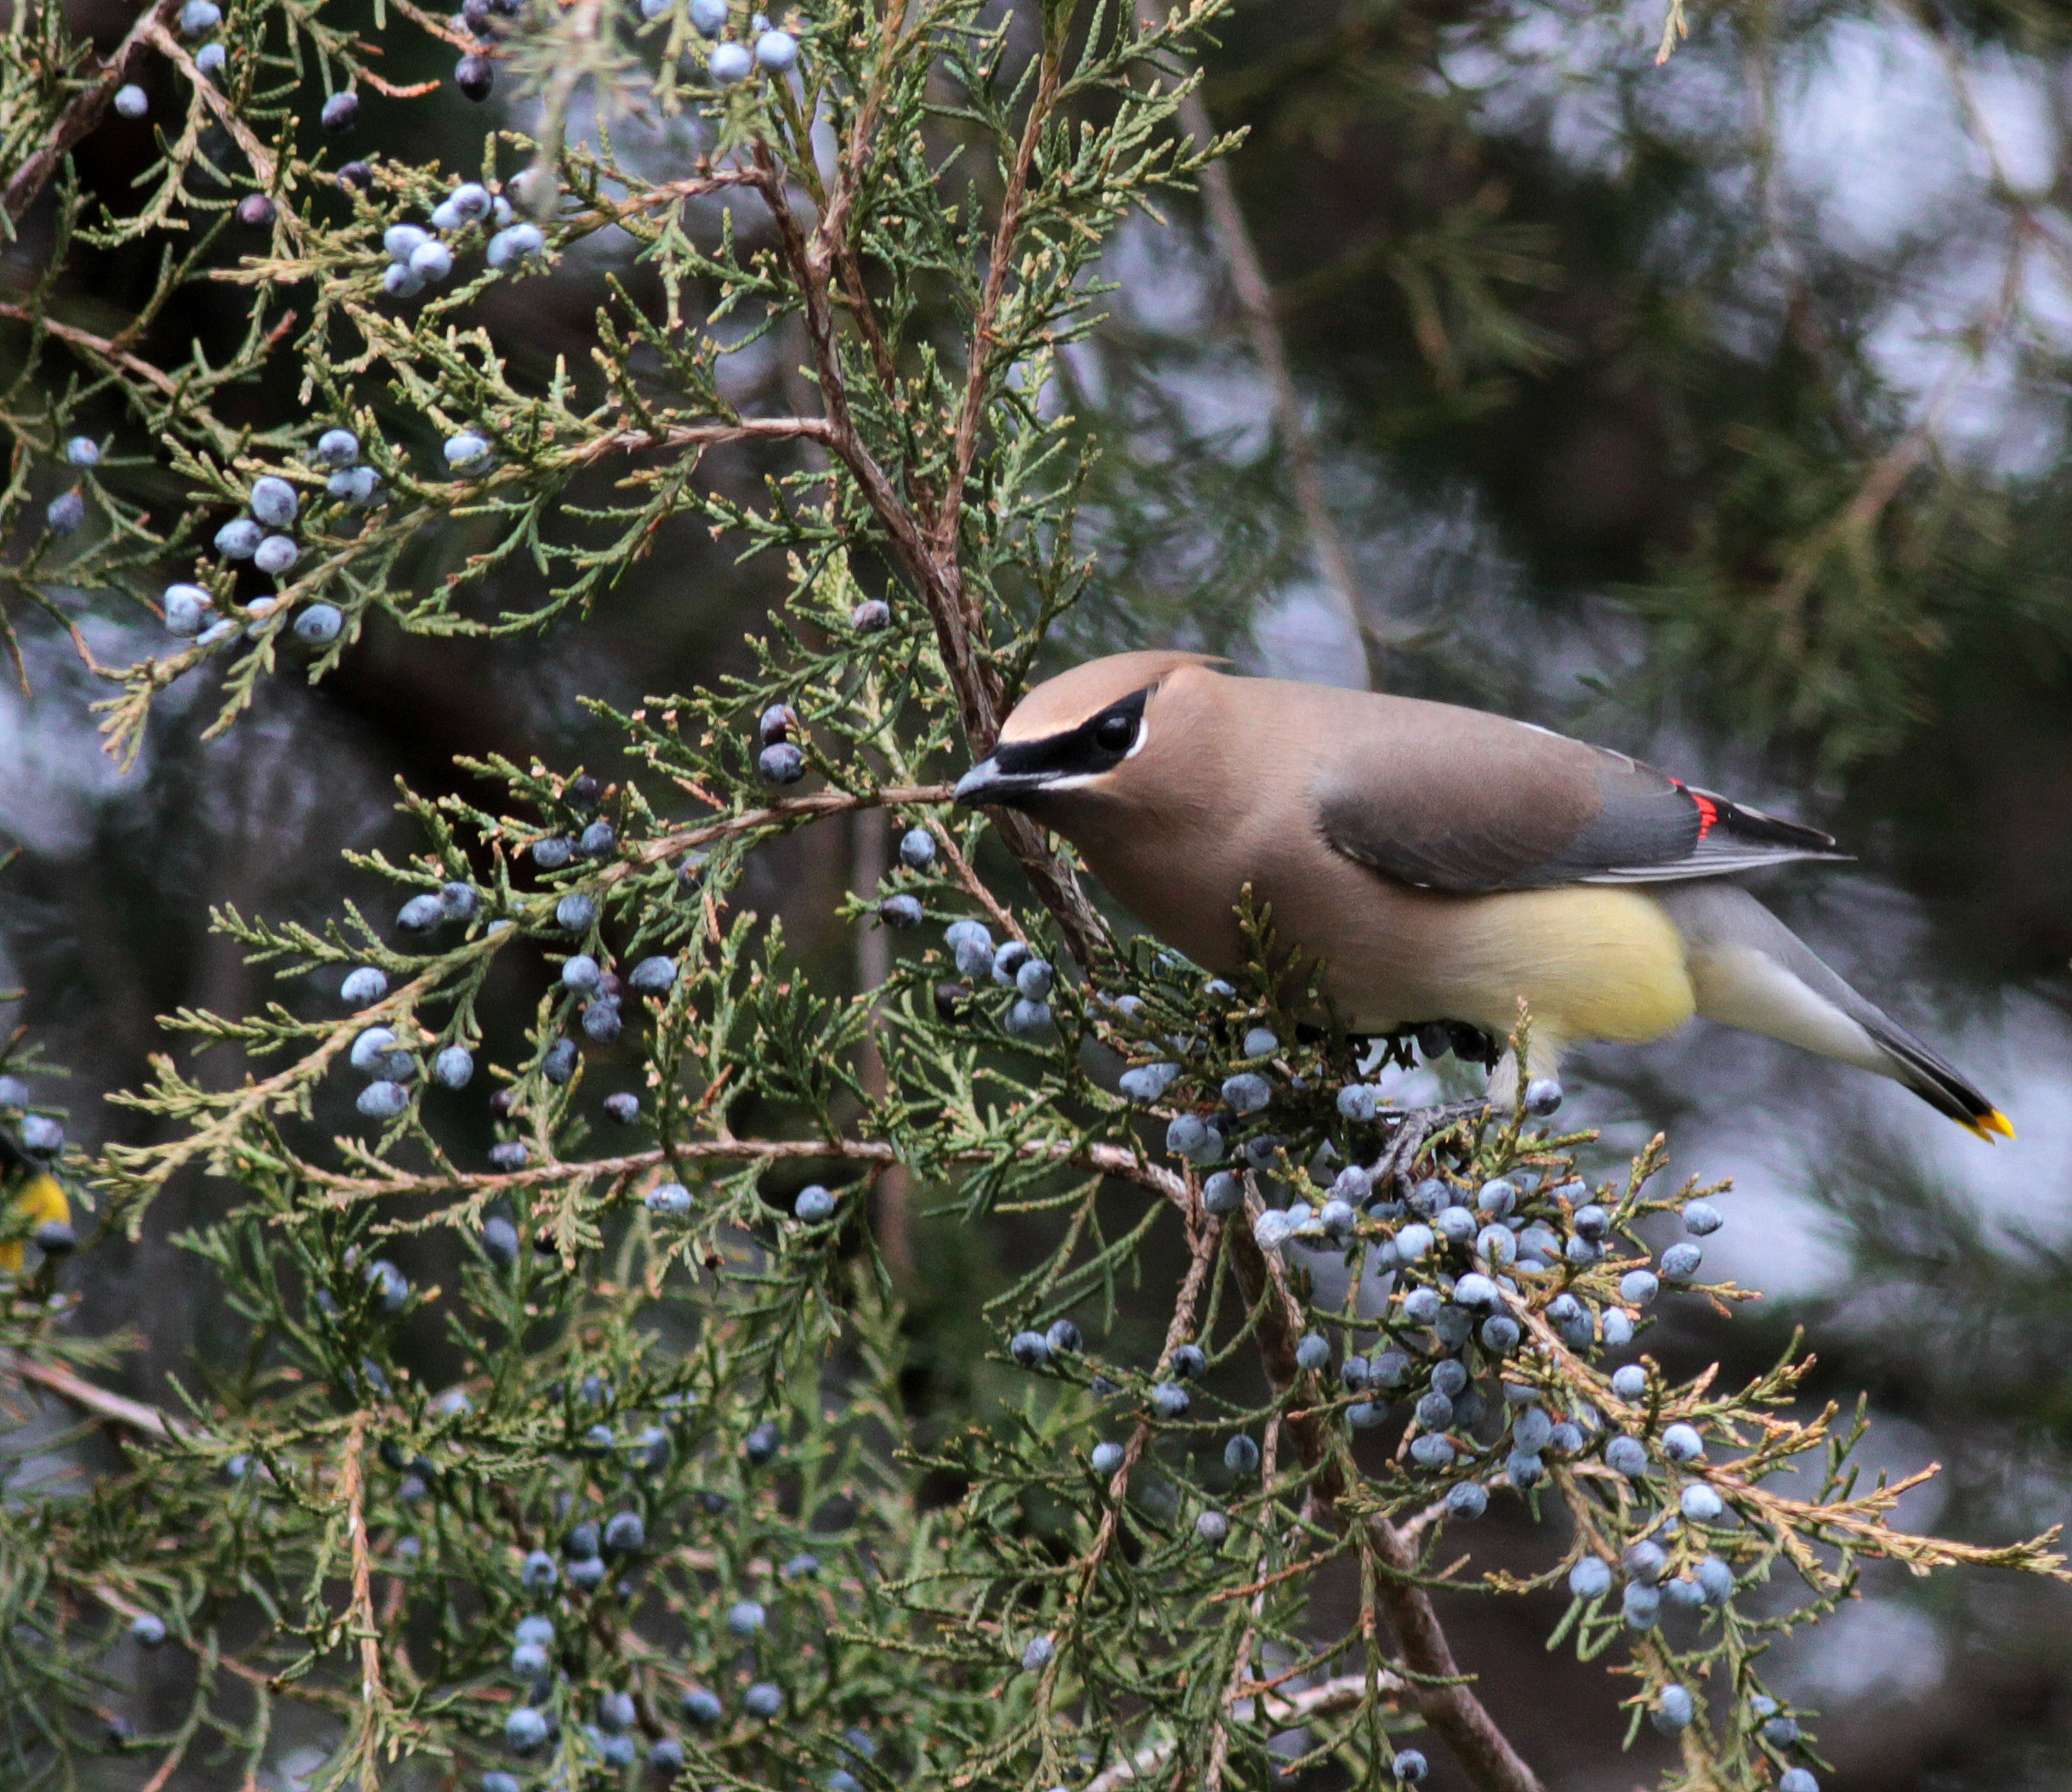
Eastern Red Cedar (BC native)
Cedar
Waxwing
Will Stuart
Notes:
More berries for winter
Waxwings, bluebirds, robins, thrashers, also goldfinches
Allstar plant – evergreen too

Slide 26
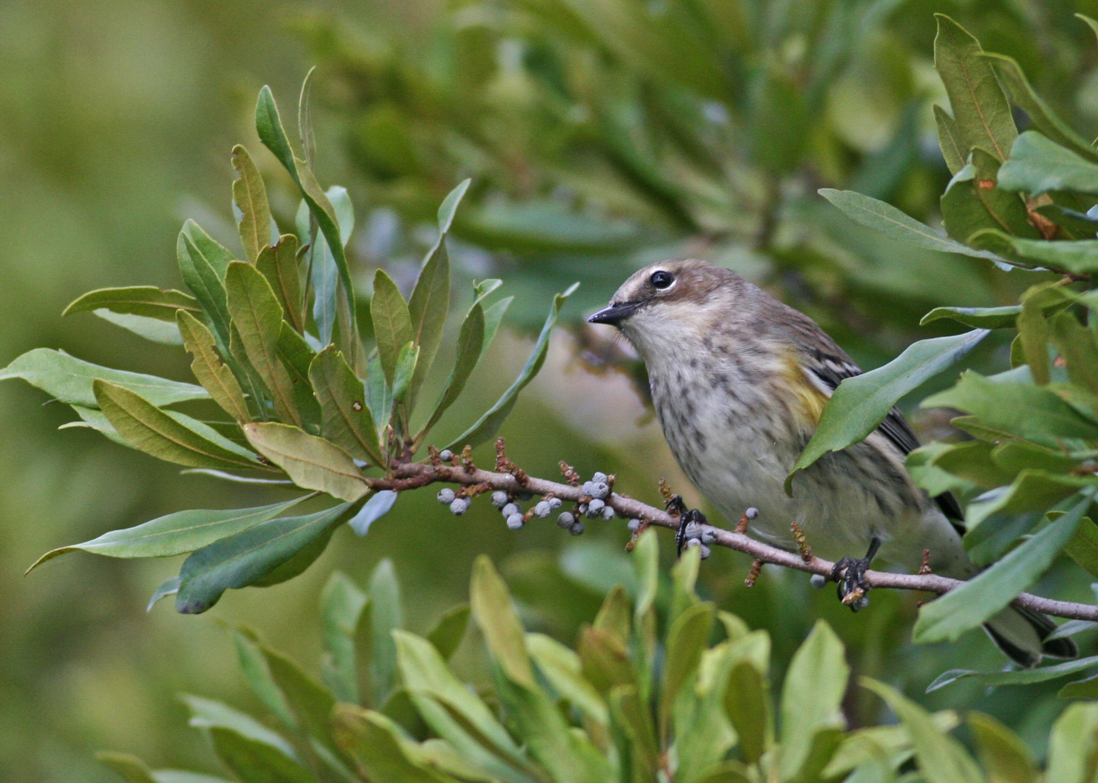
Wax Myrtle
Will Stuart
Cedar
Waxwing
Will Stuart
Notes:
More berries for winter
Waxwings, bluebirds, robins, thrashers, also goldfinches
Allstar plant – evergreen too

Slide 27
Food Group #2: Insects
Notes:
Most compelling story for why native plants matter!

Slide 28
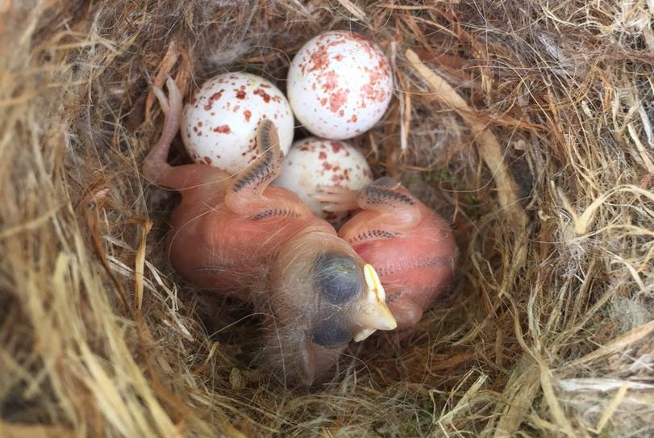
Carolina Chickadee
Janet Loew
Notes:
Food group #2 – insects
Why birds on this slide instead of insects?
All our landbirds feed their babies insects (96%) – even the birds that eat exclusively fruit or seeds as adults
Two weeks from egg hatching to a fully feathered bird that can fly
Caterpillars are the most important food for baby birds
Guess how many caterpillars it takes to raise these babies…

Slide 29
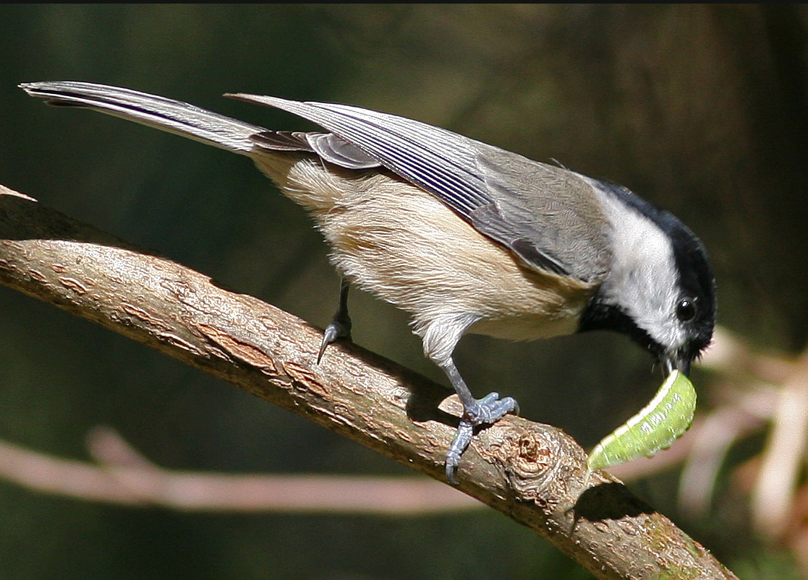
9,000 Caterpillars!
Will Stuart
Success Story #1
Notes:
9,000 caterpillars! For chickadee mom & dad to deliver in only 2 weeks.
Where they get the caterpillars is our native trees, which provide 35 TIMES the weight of caterpillars as non-native trees.
Doug Tallamy’s work – entomologist at University of Delaware

Slide 30
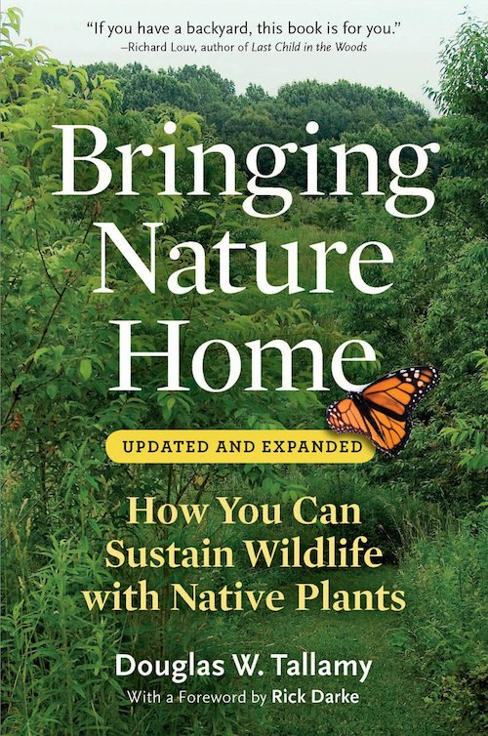
Top 10 Trees for Baby-Bird Food
Oak: Laurel, Live
Willow
Cherry: Carolina Laurel
Birch
Crabapple
Blueberry
Maple: Red
Pine: Loblolly
Hickory
Hawthorn
Will Stuart
Notes:
Top 10 native trees for caterpillars
Oak trees support >500 kinds of caterpillars
Ginkgo trees – native to Asia – support only 5 (food desert or furniture for birds)
Credit to entomologist Doug Tallamy at University of Delaware

Slide 31
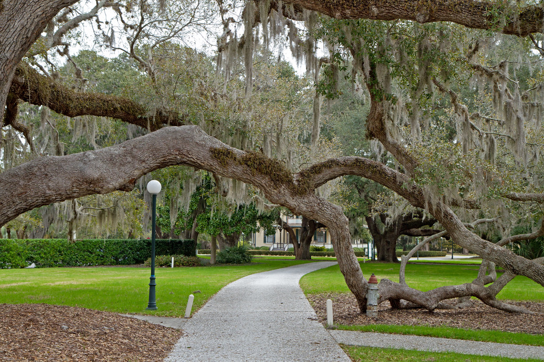
Oaks: Laurel and Live
Will Stuart
Notes:
Oaks are the #1 source of caterpillars
Comparison – native oaks support more than 500 kinds of caterpillars (moths & butterflies who lay their eggs on oaks)
Gingko tree – beautiful but does not naturally occur in North America – supports only 5 kinds of caterpillars.
Gingko is a food desert for baby birds.

Slide 32
Food Group #3: Nuts & Seeds

Slide 33
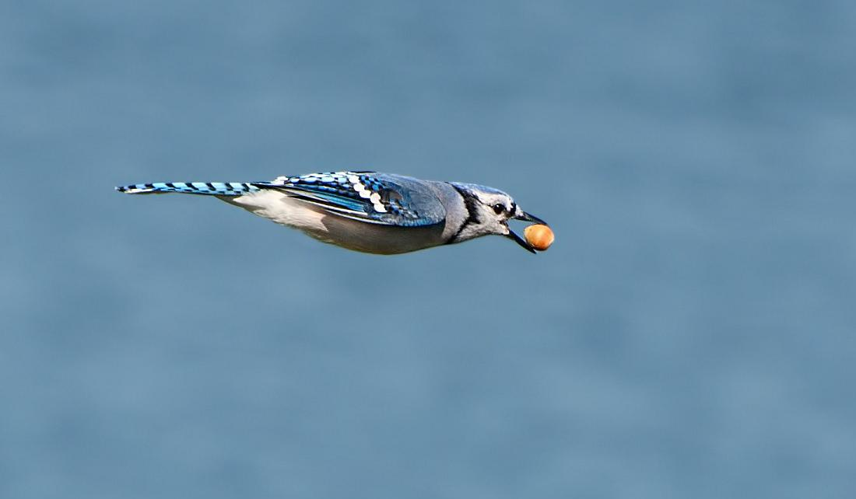
Go Nuts
Blue Jay - Susan Phillips, wildbirdy.com

Slide 34
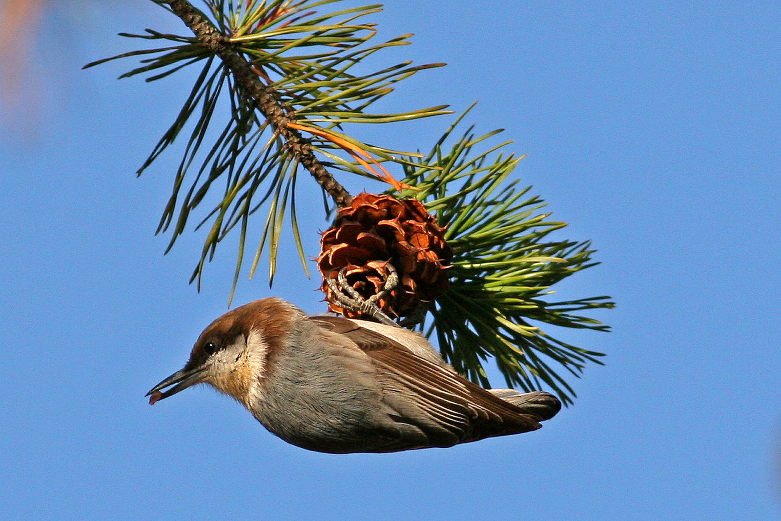

Seeds
Will Stuart
Notes:
Food group #3 – nuts and seeds
Nuthatch like many other birds stashes pine seeds to eat throughout the year especially when insects are not easy to find

Slide 35
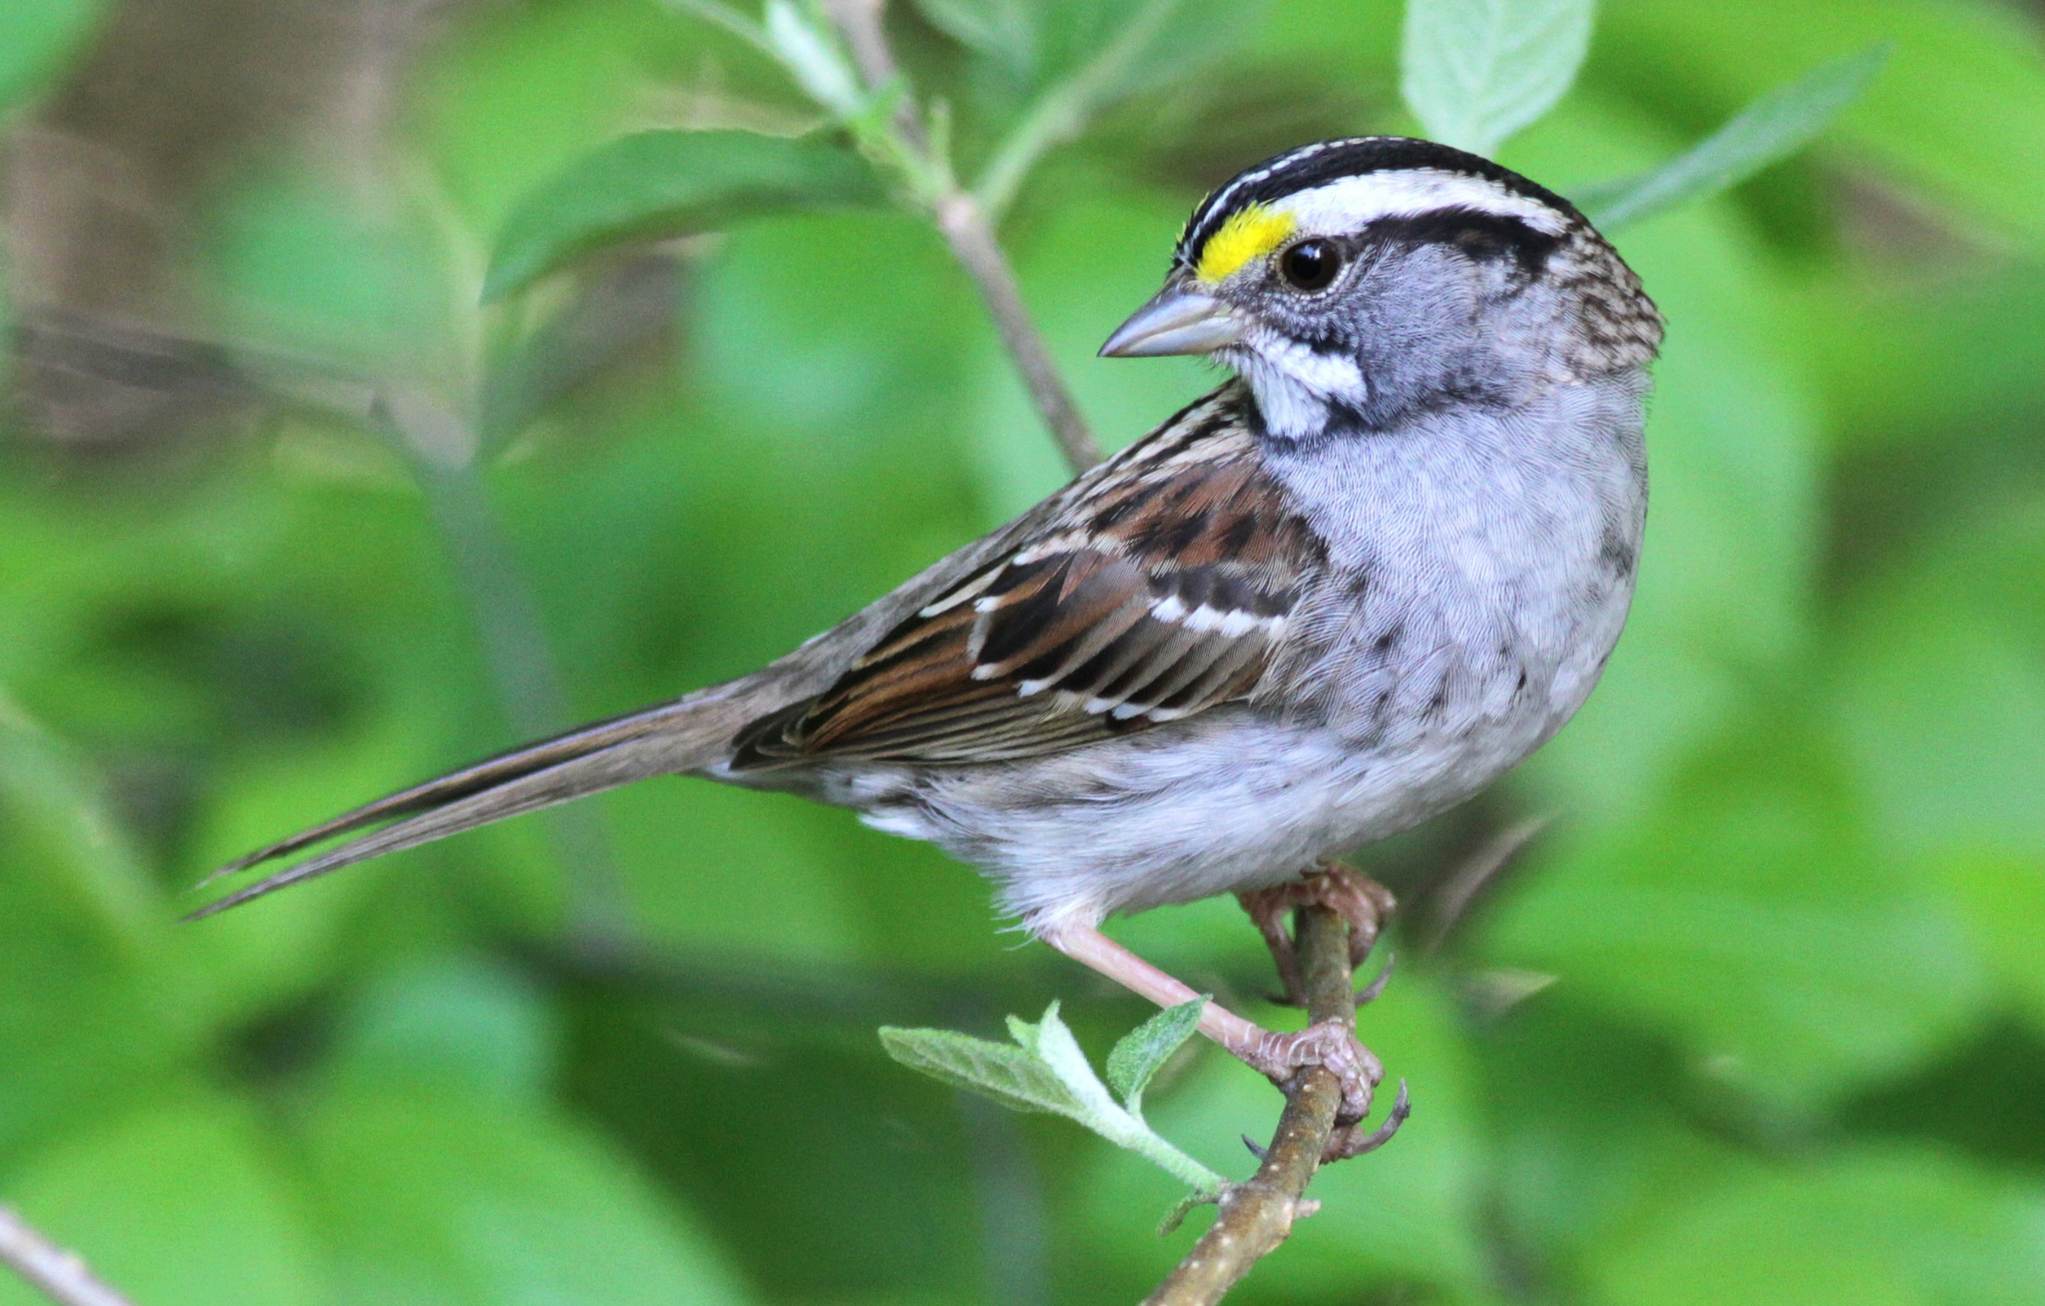
White-throated Sparrow
Will Stuart
Notes:
Food group #3 – nuts and seeds
Nuthatch like many other birds stashes pine seeds to eat throughout the year especially when insects are not easy to find

Slide 36
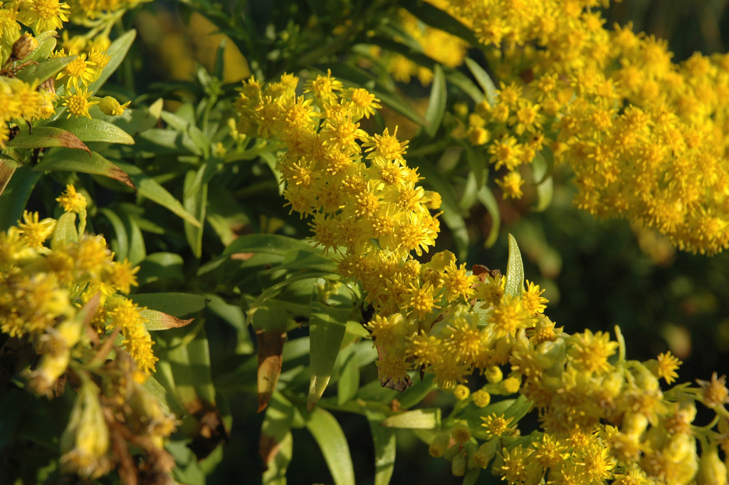
Seaside Goldenrod
David Remson
Notes:
Food group #3 – nuts and seeds
Coreopsis verticillata
Another plant we are promoting specially for birds
Abundant yellow flowers last for months, seeds Jul-Oct

Slide 37
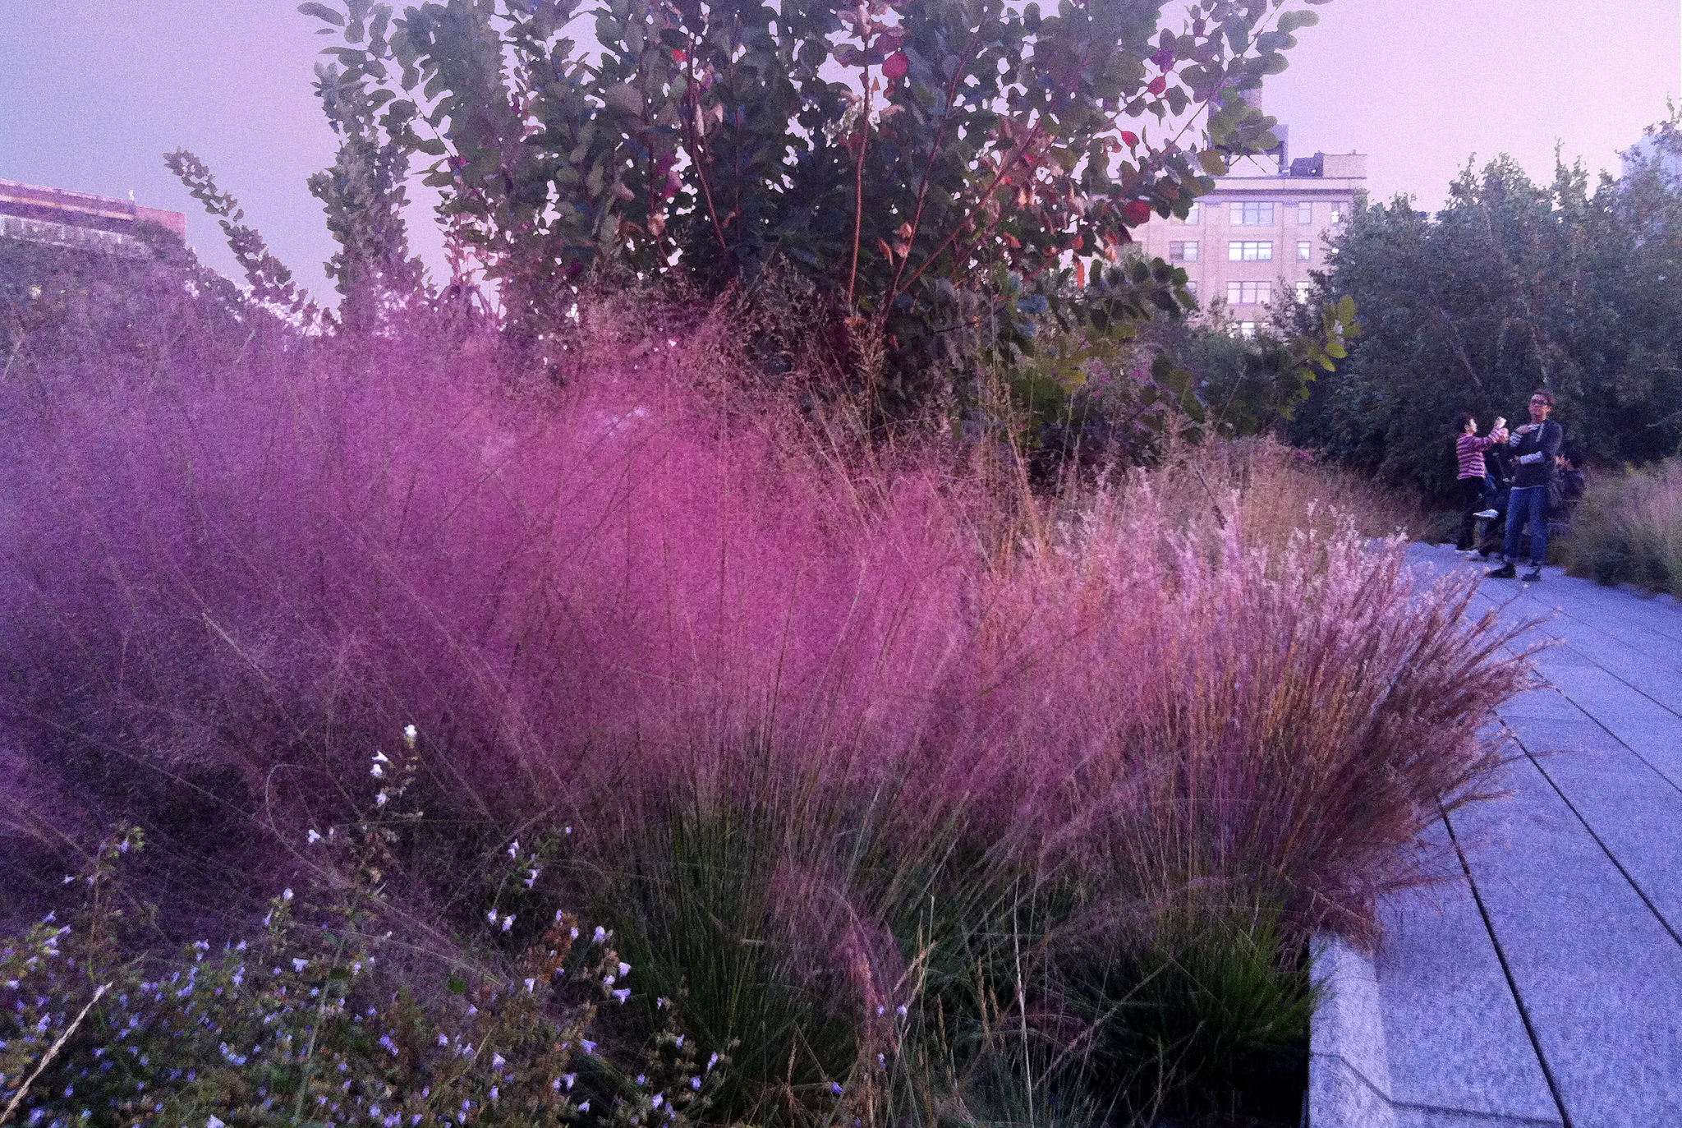
Purple Muhly Grass
John E. Branch
Notes:
Food group #3 – nuts and seeds
Coreopsis verticillata
Another plant we are promoting specially for birds
Abundant yellow flowers last for months, seeds Jul-Oct

Slide 38
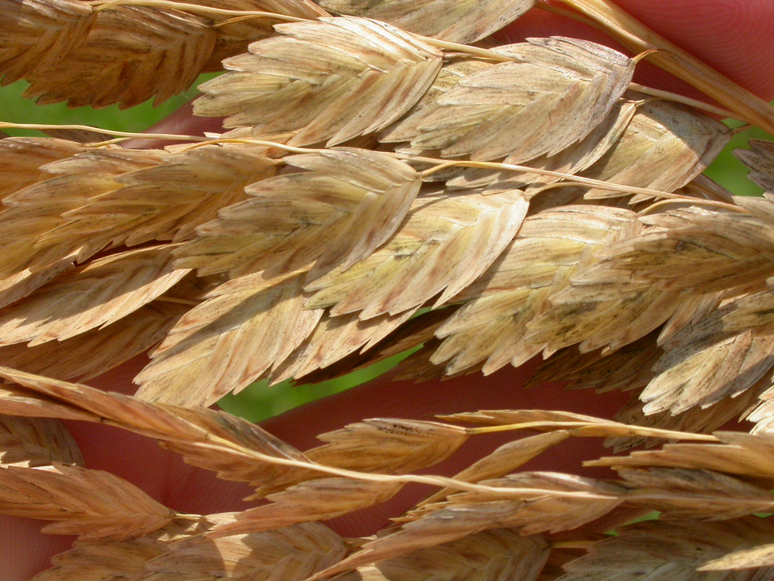
Sea Oats
Matt Lavin
Notes:
Food group #3 – nuts and seeds
Coreopsis verticillata
Another plant we are promoting specially for birds
Abundant yellow flowers last for months, seeds Jul-Oct

Slide 39
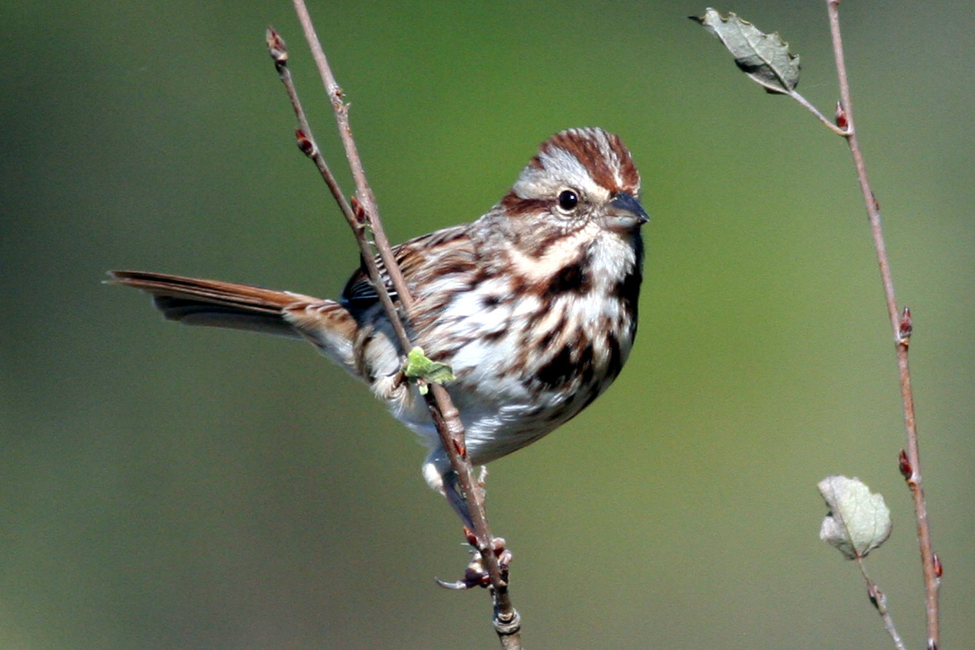
Song Sparrow – Will Stuart

Slide 40
Food Group #4: Nectar

Slide 41

Coral Honeysuckle, Lonicera sempervirens
Will Stuart
Notes:
Food group #4 – Nectar for hummingbirds
Just one breeding hummingbird – Ruby-throated
This little bird crosses the Gulf of Mexico twice a year
(though some hummingbirds now winter in NC where people have feeders up… Rufous Hummingbird)
Flowers Mar-Jul+

Slide 42
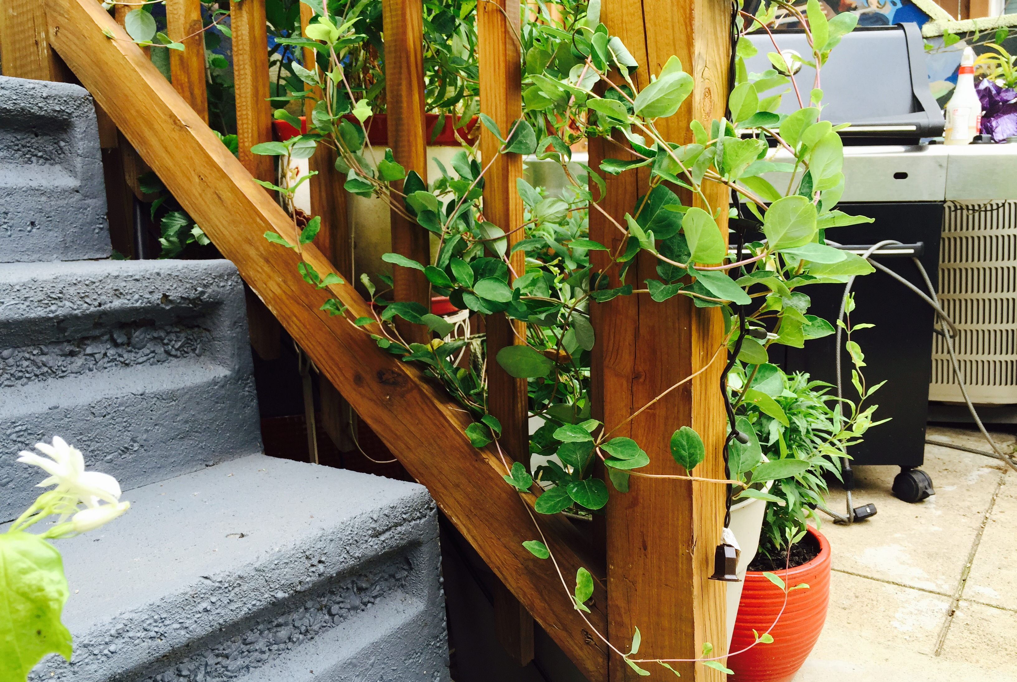

Slide 43
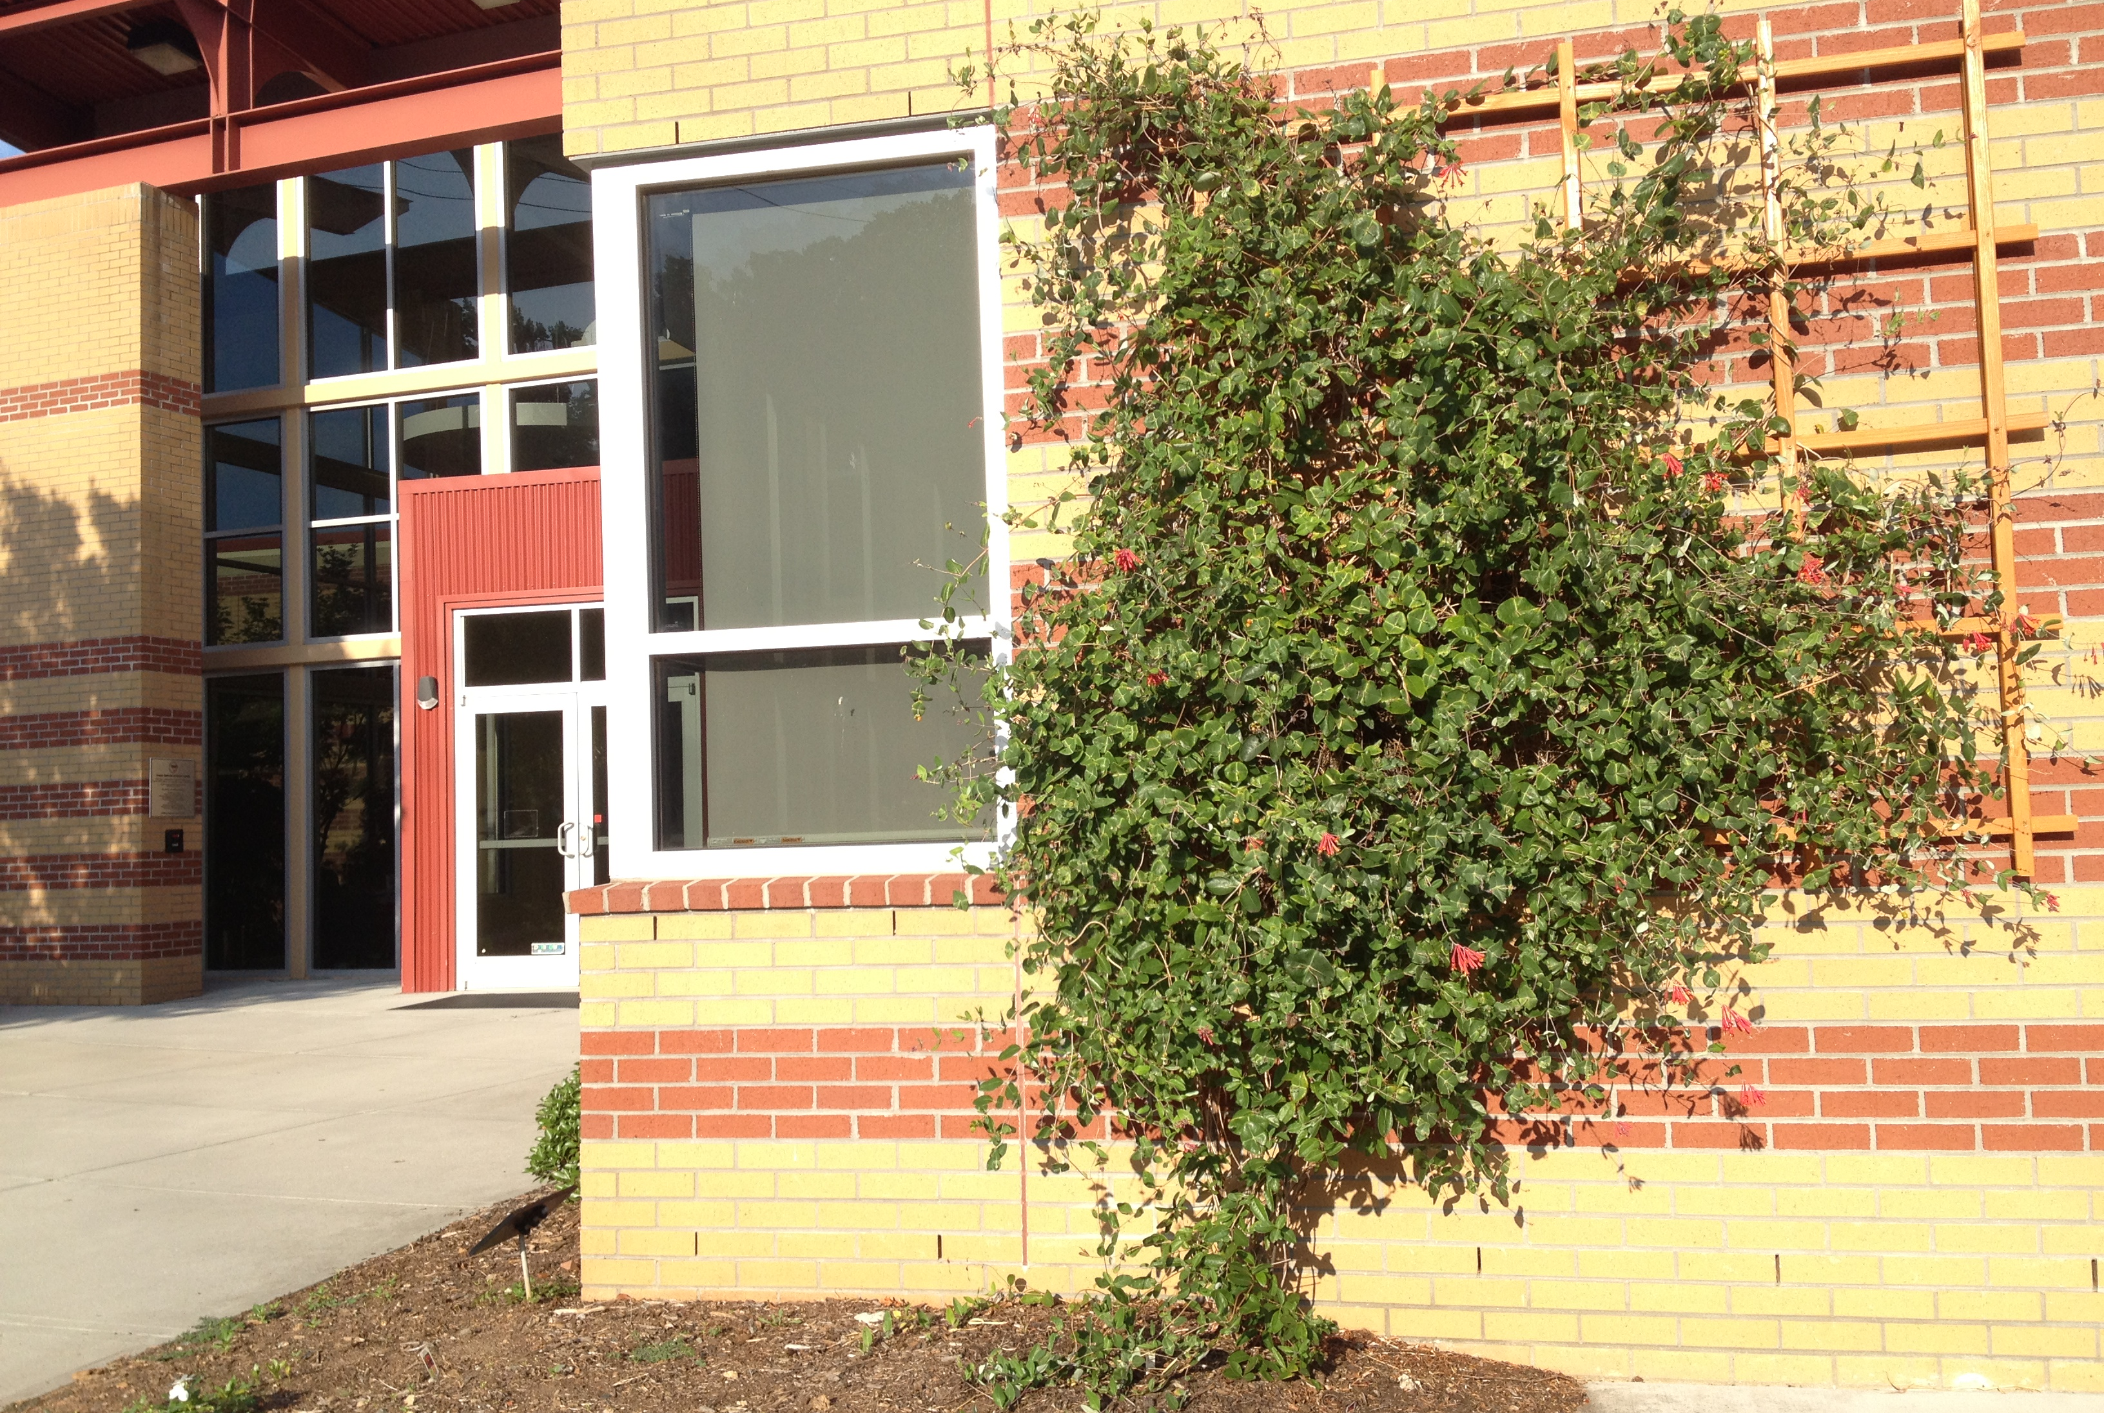

Slide 44
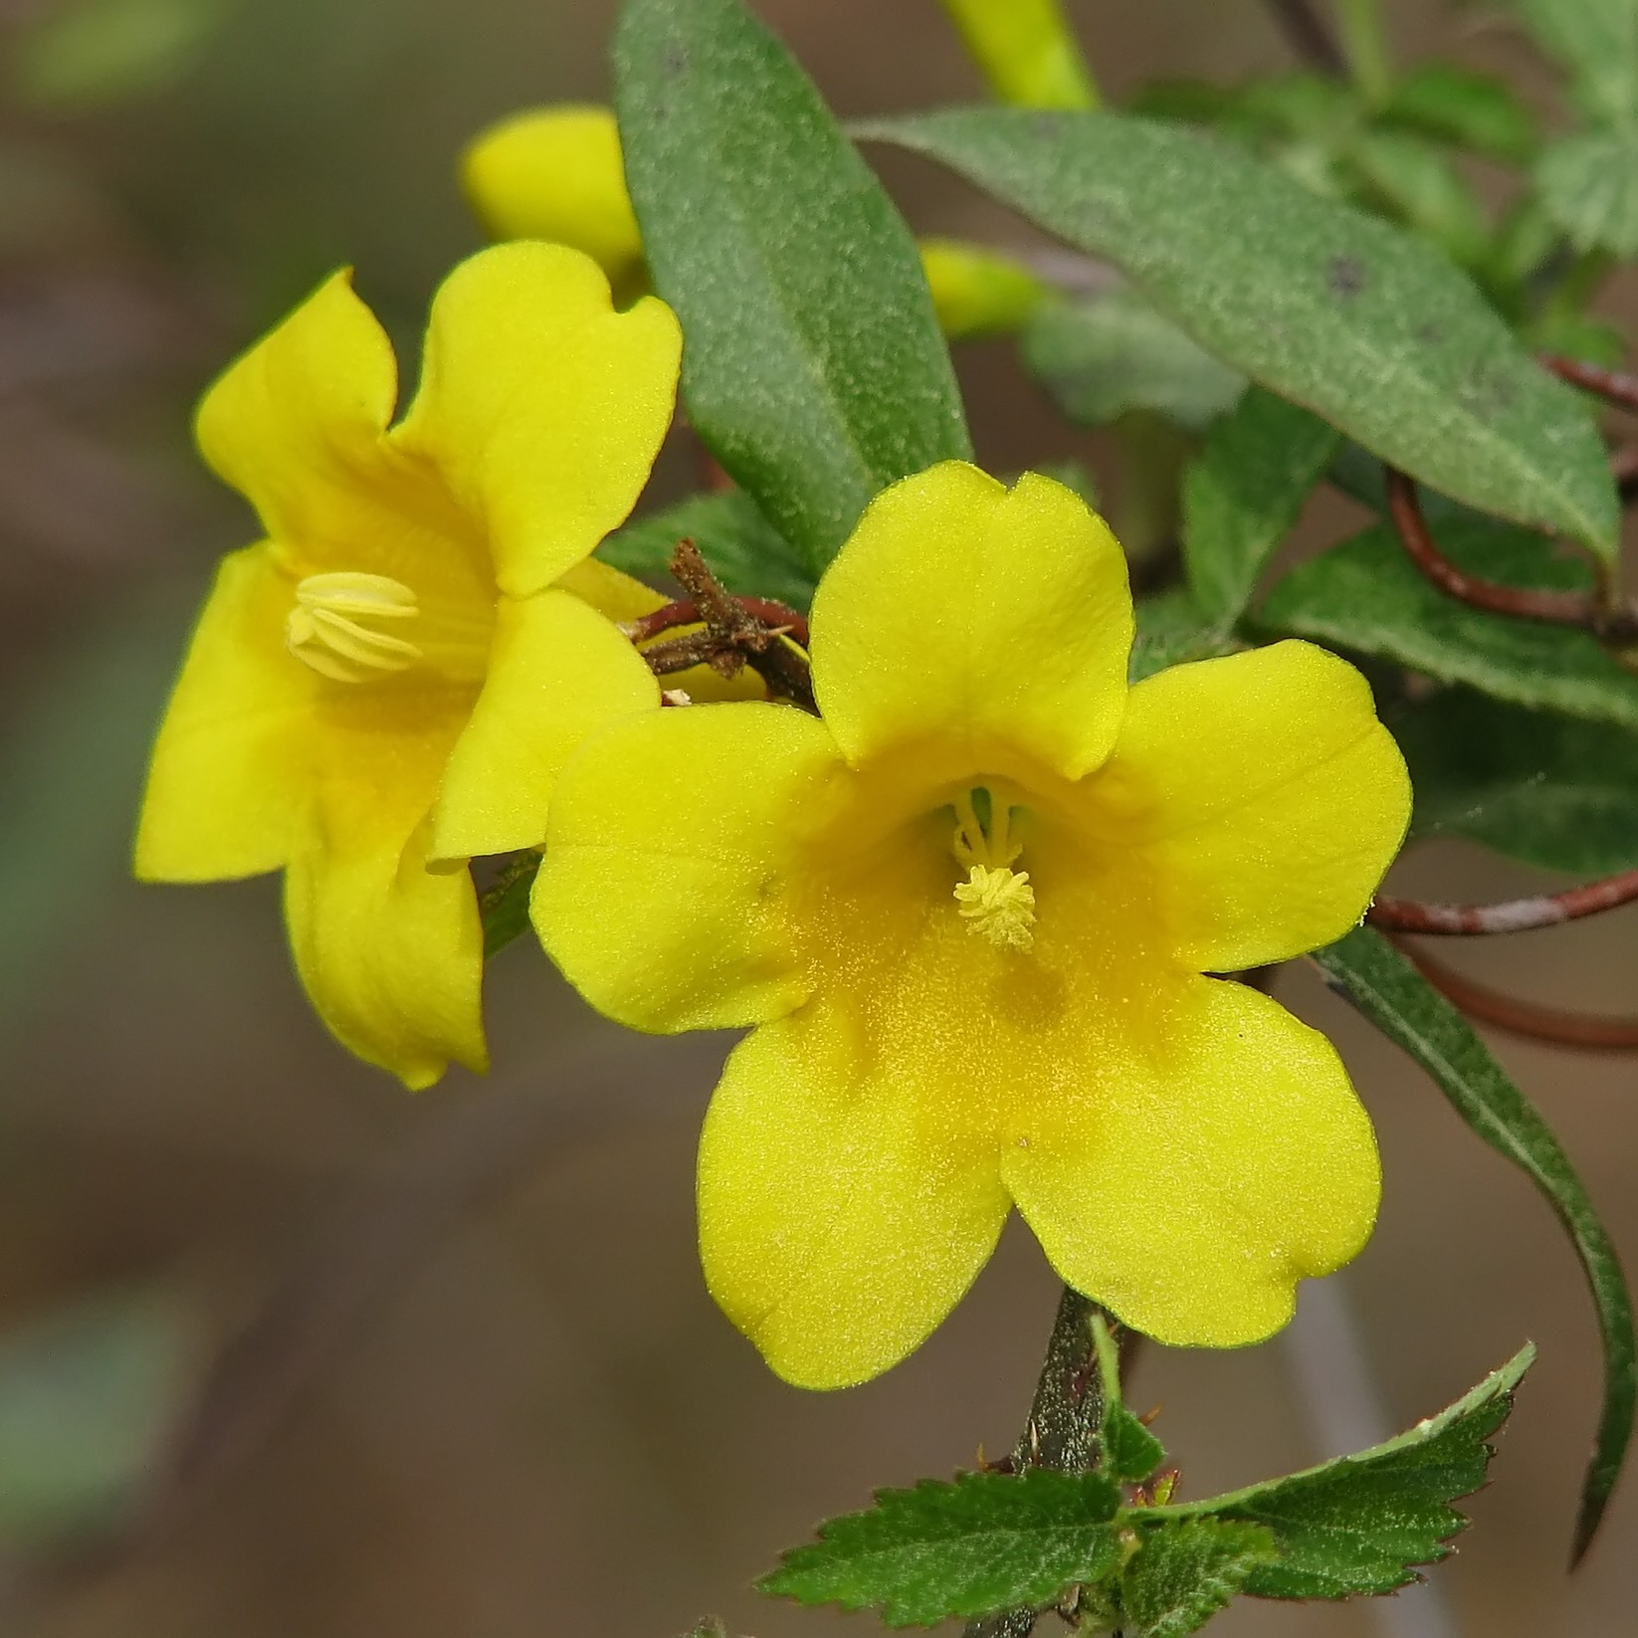
Carolina Jessamine
Vicki DeLoach
Will Stuart
Notes:
Aquilegia Canadensis
Flowers Mar-May

Slide 45
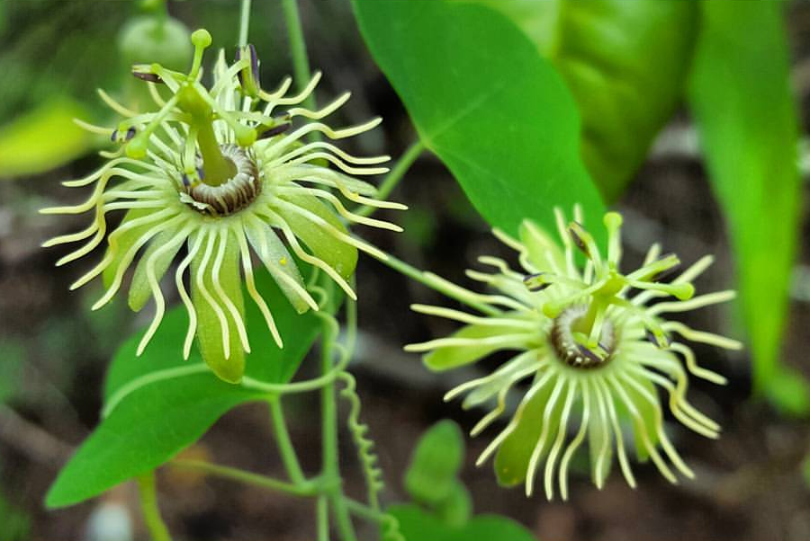
Passionflower, Passiflora lutea
Geoffrey Neal
Notes:
Food group #4 – Nectar for hummingbirds
Cardinalflower in bloom right now – important for fall migration
Flowers Jul-Oct
Could mention LOTS more great nectar plants for hummers! Native azaleas, phlox, more vines, etc.

Slide 46
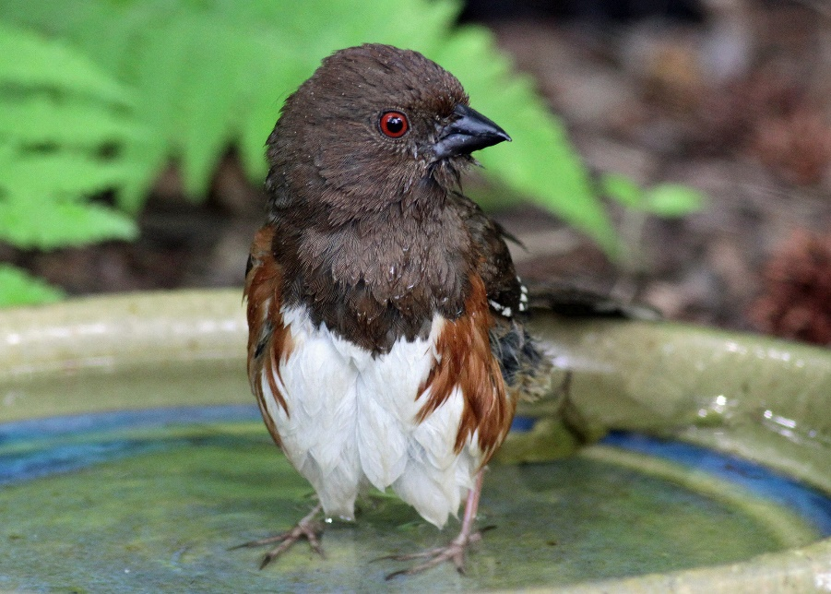
Water
Eastern Towhee – Will Stuart

Slide 47
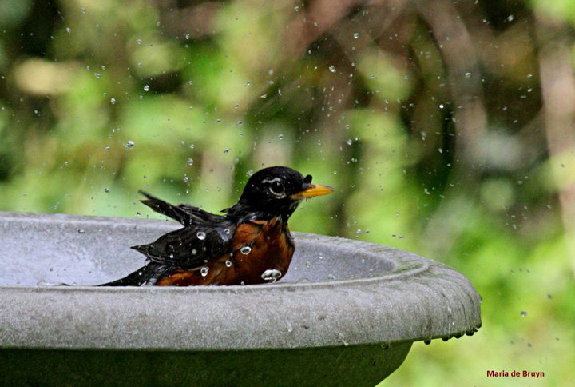
Water
Will Stuart
Notes:
Other ways to help – water
(think about birds with tiny short legs too – shallow bird bath with a slope is best)
Running water even better – the #1 thing you can do to SEE more birds in your yard.

Slide 48
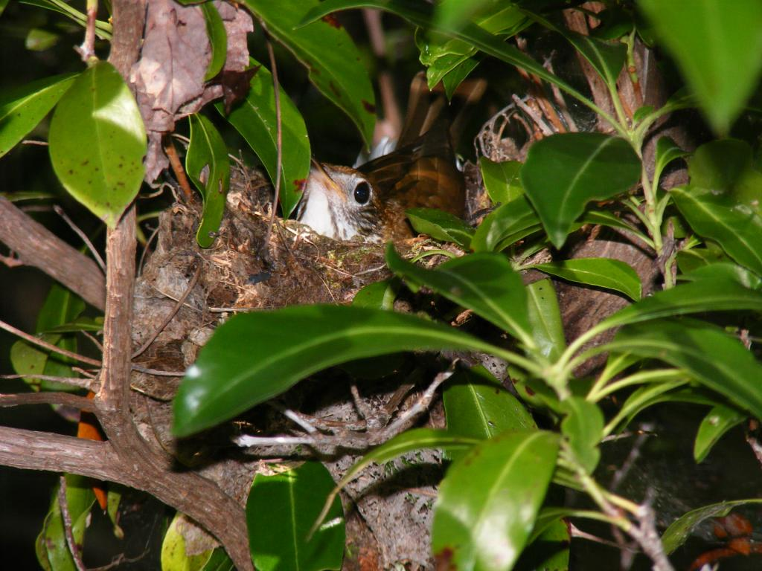
Shelter and Nest Sites
Wood Thrush
John Gerwin

Slide 49
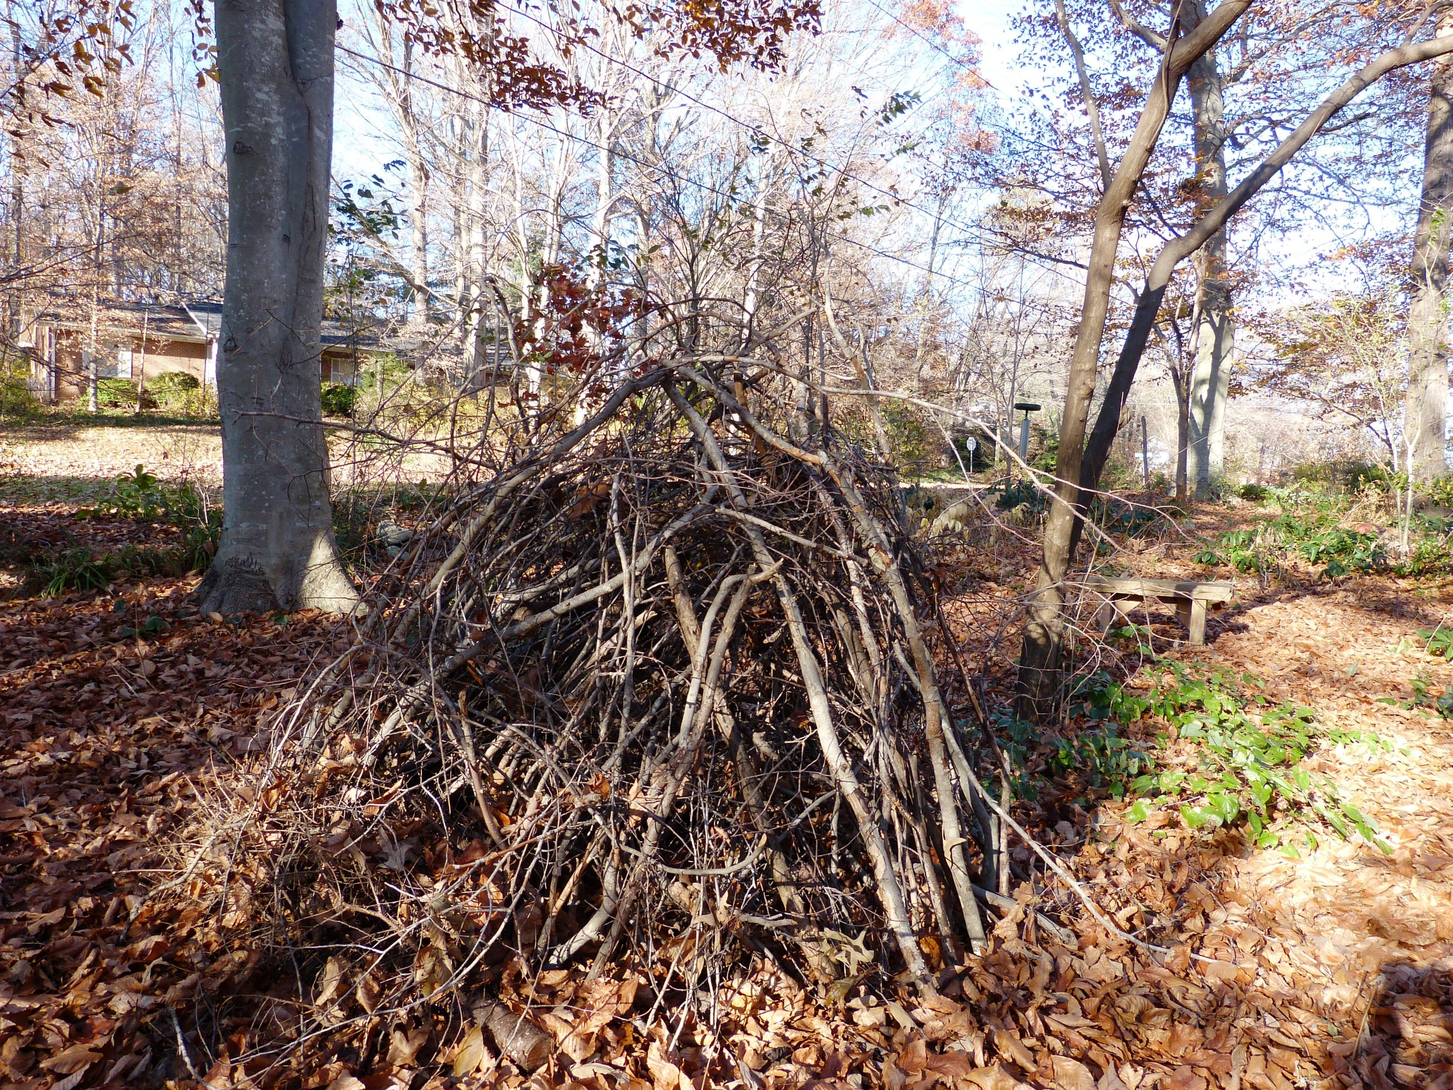
Build a Brush Pile
Shelley Rutkin

Slide 50
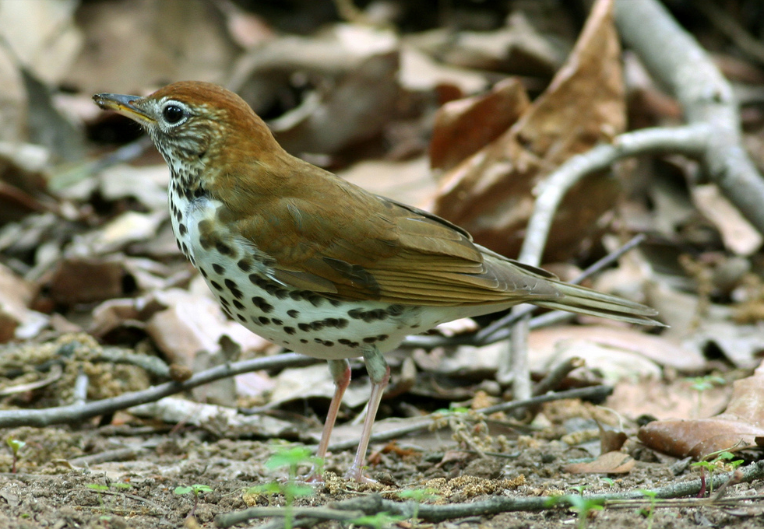
Leaf Litter
Wood Thrush
Will Stuart

Slide 51
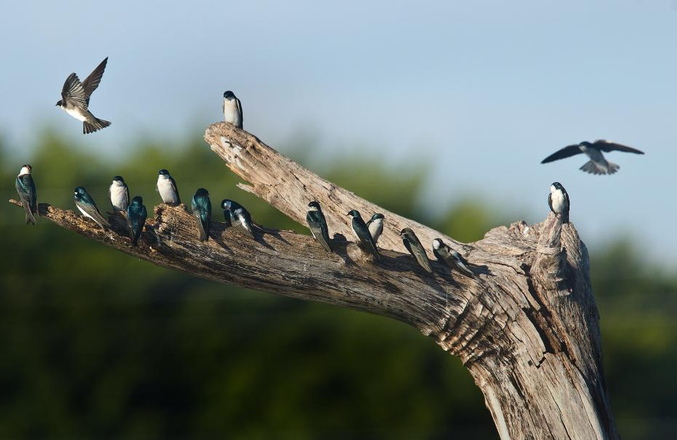
Snags
Tree Swallows - Donald Mullaney

Slide 52
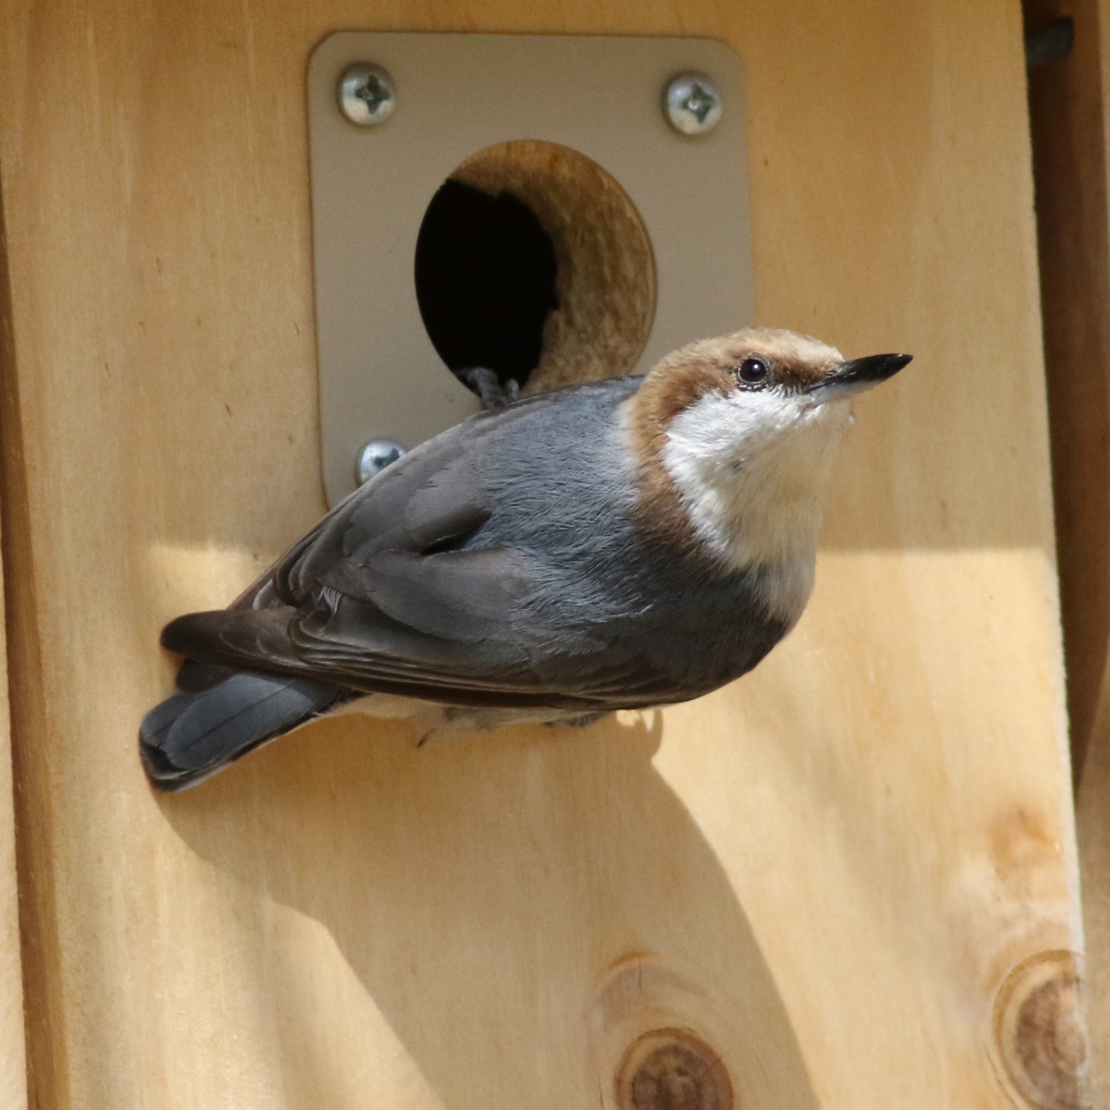
Nest Boxes
Will Stuart
Notes:
Other ways to help – nest boxes
10,000 Nest Boxes for Nuthatches – inspired people across North Carolina to put up these boxes, which are just like bluebird boxes but have a smaller hole. We’re just about to 9,000 now.

Slide 53
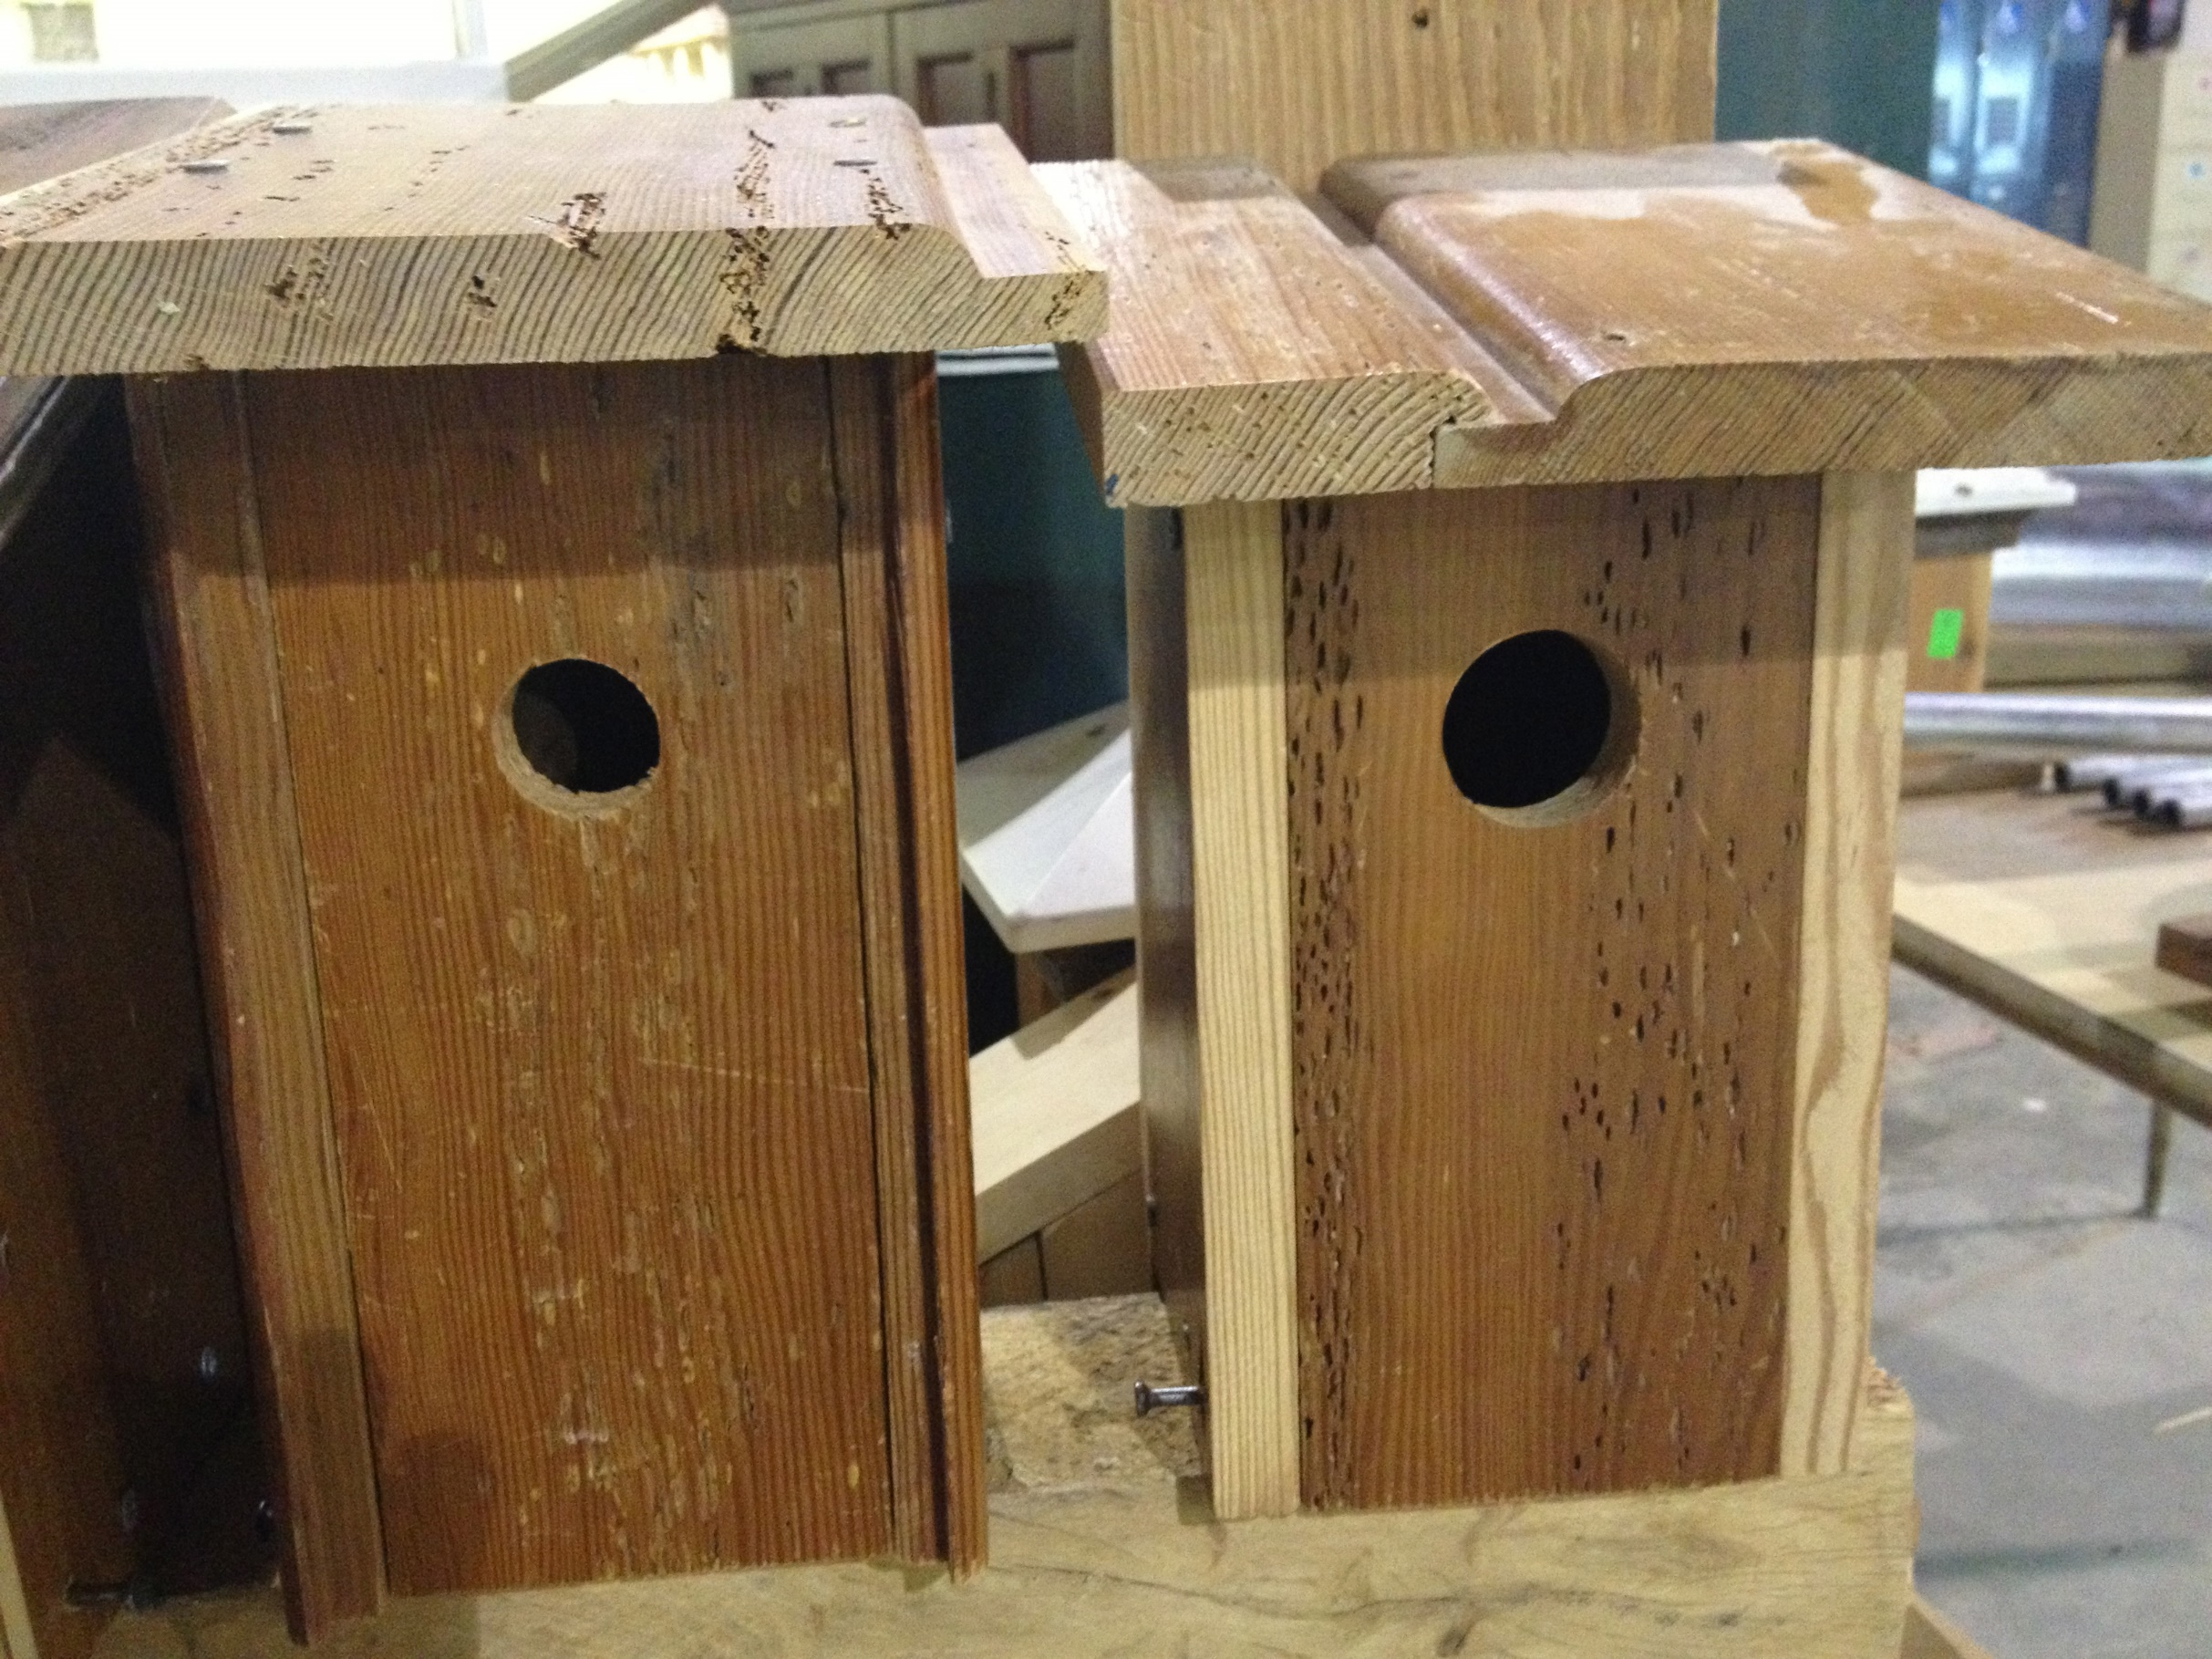
Varied Hole Sizes
Kim Brand

Slide 54
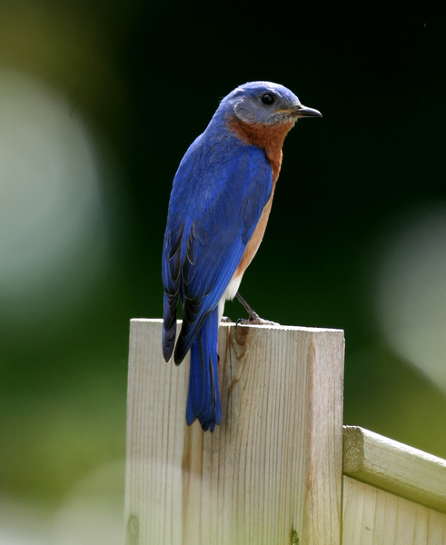
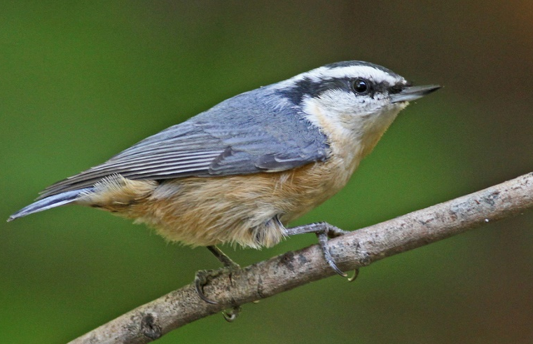
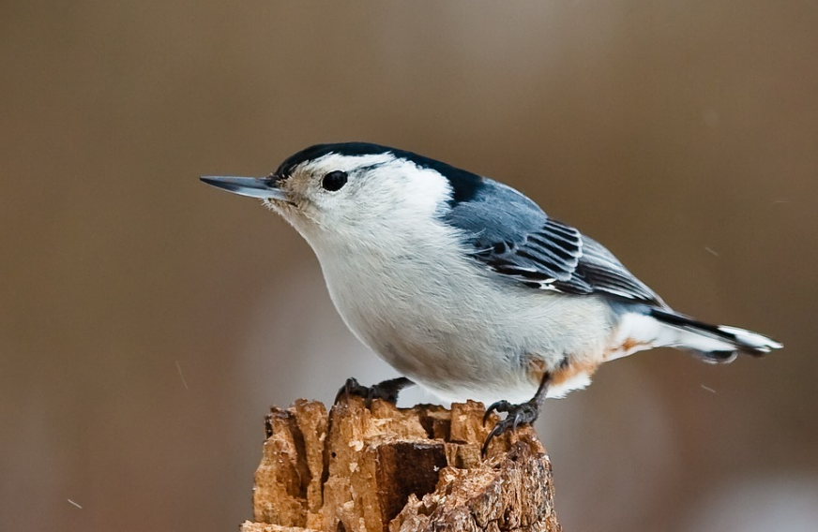
More Nest Box Birds
Red-breasted Nuthatch
Will Stuart
Eastern Bluebird
Will Stuart
White-breasted Nuthatch
Jason Paluck, Flickr Creative Commons

Slide 55
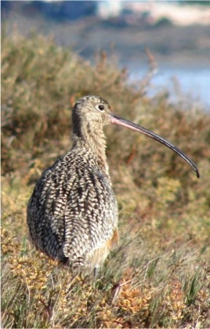

The Bird-Friendly Yard
  Food
  Water
  Shelter & Nest Sites
  Layers

Slide 56

Cats Indoors
Cedar Waxwing - flyawayunlimited.com

Slide 57

Jill Palmer

Slide 58

2014 Report:
  Half our birds are at risk from climate change
  40 years of bird data
Notes:
The Brown-headed Nuthatch is one of more than 300 birds Audubon has identified as climate-endangered or climate-threatened (the nuthatch is climate-endangered).

Slide 59

Bird-Friendly is Climate-Friendly:
  Directly reduces greenhouse gas emissions
  Increases carbon storage
  Builds resilient bird populations
Will Stuart
Notes:
And here is why bird-friendly equals climate friendly:
Bird gardening makes a direct impact on your carbon footprint.
Directly reduces greenhouse emissions
Lawnmowers account for up to 5% of greenhouse gas emissions in the US
Fertilizer releases a powerful greenhouse gas – nitrous oxide
Increases carbon storage – lawn stores some carbon, but trees and shrubs store more.
Builds resilient bird populations – a yard full of native plants provides the food resources birds need to
Feed their babies
Refuel during migration
Survive and thrive during the winter and all year round

Slide 60

Audubon Ambassadors
Coming Soon to Southport!
Notes:
We partner with nurseries to grow and sell Bird-Friendly Native Plants with the goal of making it easy for any North Carolinian to buy native plants easily.
Photo by Kim Brand

Slide 61

Notes:
We partner with nurseries to grow and sell Bird-Friendly Native Plants with the goal of making it easy for any North Carolinian to buy native plants easily.
Photo by Kim Brand

Slide 62

Notes:
We partner with nurseries to grow and sell Bird-Friendly Native Plants with the goal of making it easy for any North Carolinian to buy native plants easily.
Photo by Kim Brand

Slide 63

Cardinalflower, Lobelia cardinalis
Will Stuart
Notes:
Food group #4 – Nectar for hummingbirds
Cardinalflower in bloom right now – important for fall migration
Flowers Jul-Oct
Could mention LOTS more great nectar plants for hummers! Native azaleas, phlox, more vines, etc.

Slide 64

Wild Columbine
Will Stuart
Notes:
Aquilegia Canadensis
Flowers Mar-May

Slide 65

Eastern Blue Phlox
Will Stuart
Notes:
Phlox divaricata
Flowers Apr-May

Slide 66

Eastern Blue Phlox
Flickr Creative Commons
Notes:
Phlox divaricata
Flowers Apr-May

Slide 67

Trumpet Vine
Ruby-throated Hummingbird - Will Stuart
Notes:
Campsis radicans
Flowers Jun-Oct

Slide 68

Virginia Sweetspire, Itea virginica
Will Stuart
Notes:
Flowers May-Jun

Slide 69

Crossvine
Will Stuart
Notes:
Bignonia capreolata
Flowers Apr-May

Slide 70

Black-eyed Susan, Rudbeckia
Kim Brand
Notes:
Food group #3 – nuts and seeds
Besides pine seeds, acorns that birds store for later – want to have a cascade of flowers that produce seeds for finches & sparrows
Leave plenty of flowers be (don’t deadhead) – seeds Jul-Oct

Slide 71

Eastern Aromatic Aster
Will Stuart
Notes:
Food group #3 – nuts and seeds
Also need some late-blooming flowers so birds have seeds for winter – Asters Oct-Nov

